Slide 1





CyberGuard:
Comprehensive Threat Detection & Monitoring System
Name: Himil Prajapati
M.Sc. Digital Forensics and Information Security
Sem: IV
Enrolment No: 012200300003011
Guide: Dr. Lavi Tyagi

Slide 2


currently I am serving as a CISO intern at Netskope in Bangalore. In this role, he collaborates closely with both the forensic and security teams. He is engaged in a project focused on using Seclytics to ensure that Netskope's IPs are protected from being blacklisted on any domain.

Slide 3
Contents
Introduction | In troduction of the Project
Literature Review | Studies of the research papers
Research Gap | What is found and analysis
Objective | What is main objective of the project
Flow Chart | The flow chart for high level understandings
Methodology | Strategy of implementation of project
Implementation | Real testing and implementation of the project
References | All the reference contacts

Slide 4
ABSTRACT!
In today's interconnected digital landscape, the need for robust threat detection and monitoring mechanisms has never been greater. Effective threat detection and monitoring are critical components of any robust cybersecurity strategy, enabling organizations to identify, assess, and mitigate potential risks proactively.
This project aims to introduce a comprehensive approach to identifying and overseeing potential threats in various digital environments. Leveraging open-source technology, we propose a multifaceted strategy that integrates advanced detection algorithms, real-time monitoring systems, and proactive threat intelligence analysis.
Small and Medium-sized organizations often face unique challenges, such as limited IT budgets and resources, which can make it difficult to implement and maintain effective cybersecurity measures. My Project addresses these challenges by providing scalable and affordable solution that do not compromise on security

Slide 5
Introduction!
In today's interconnected digital landscape, the need for robust threat detection and monitoring mechanisms has never been greater. Effective threat detection and monitoring are critical components of any robust cybersecurity strategy, enabling organizations to identify, assess, and mitigate potential risks proactively.
This project aims to introduce a comprehensive approach to identifying and overseeing potential threats in various digital environments. Leveraging open-source tools, we propose a multifaceted strategy that integrates advanced detection algorithms, real-time monitoring systems, and proactive threat intelligence analysis.

Slide 6
Objective!
The objective of our research is to:
Enhance IT security using open-source technologies, prioritizing Linux and Windows environments.
Develop robust mechanisms for detecting and monitoring USB devices to prevent unauthorized data transfers.
Implement solutions for SSH detection and blocking to prevent unauthorized access attempts and strengthen network security.
Strengthen malware detection capabilities to identify and mitigate potential threats, safeguarding systems and data integrity.
Conduct comprehensive vulnerability scanning to identify security weaknesses and prioritize remediation efforts.
Establish File Integrity Monitoring (FIM) systems to detect unauthorized changes to critical system files, ensuring system integrity.
Deploy Intrusion Detection Systems (IDS) to monitor network traffic and detect suspicious activities or potential security breaches.

Slide 7
Literature Review
Paper / Article | Description
Comparative analysis of IBM Qradar and Wazuh for security information and event management. Research Paper by: Dario Suskalo, Zlatan Moric, Jasmin Redzepagic and Damir Regvart [December 2023] | The aim was to evaluate their performance in addressing security challenges, especially after updates or in community-driven environments. QRadar excels in comprehensive security features and scalability, suitable for large enterprises, while Wazuh provides a cost-effective open-source option, recommended for smaller companies with limited budgets.
Intrusion Detection using Open Source Tools Research Paper by: Jack TIMOFTE [January – 2008] | In this paper, they have discussed the benefits and challenges of open-source intrusion detection systems (IDS) like OS-SEC, Prelude, and Snort, and explore their relationship with commercial support. They examines how organizations, both large and small, can effectively leverage open-source and commercial IDS solutions to enhance their network security posture.

Slide 8
Literature Review
Paper / Article | Description
Information And Security Event Management System Research Paper by: Information And Security Event Management System | This Paper focuses on proposing, analyzing, and evaluating cybersecurity solutions based on the Elastic Stack (ELK), which is widely used as an enterprise-grade logging suite and search engine. It discusses the importance of efficient log analysis, the impact of GDPR compliance within the ELK environment, and the role of Elasticsearch as a search engine.
A Survey on Network Security Monitoring: Tools and Functionalities Research Paper by: Z. S. Younus, M. Alanezi | This paper explores the growing prevalence of cybersecurity breaches and their impact on network infrastructure. It highlights various protective measures such as antivirus software, firewalls, intrusion detection systems (IDS), and intrusion prevention systems (IPS) are employed to secure network devices.

Slide 9
Literature Review
Paper / Article | Description
A Review of Wazuh Capabilities for Detecting Attacks Based on Log Analysis Research Paper by: Stefan Stanković, Slavko Gajin, and Ranko Petrović [June -2022] | The aim of the paper is to demonstrate Wazuh's effectiveness in detecting various attack. The paper suggests integrating Wazuh with Suricata, a Network Intrusion Detection System capable of generating JSON logs, for enhanced security insights.
Analysis of attacks and prevention methods in cybersecurity Research Paper by: Prof. Francesco Gringoli [October, 2022] | The thesis aims to evaluate Wazuh's effectiveness as an open-source tool for IT infrastructure protection, with a focus on threat detection, vulnerability management, and prevention.

Slide 10
Research Gap
Small startup companies often face financial constraints, limiting their access to commercial cybersecurity solutions. This creates a significant gap in providing affordable and effective security measures tailored to their needs.
To address this challenge, our research focuses on leveraging various automation techniques and integrating open-source tools to develop a comprehensive cybersecurity solution specifically designed for small businesses. By combining these technologies, we aim to offer a cost-effective alternative to traditional cybersecurity approaches, empowering startups to enhance their security posture without incurring significant expenses.

Slide 11
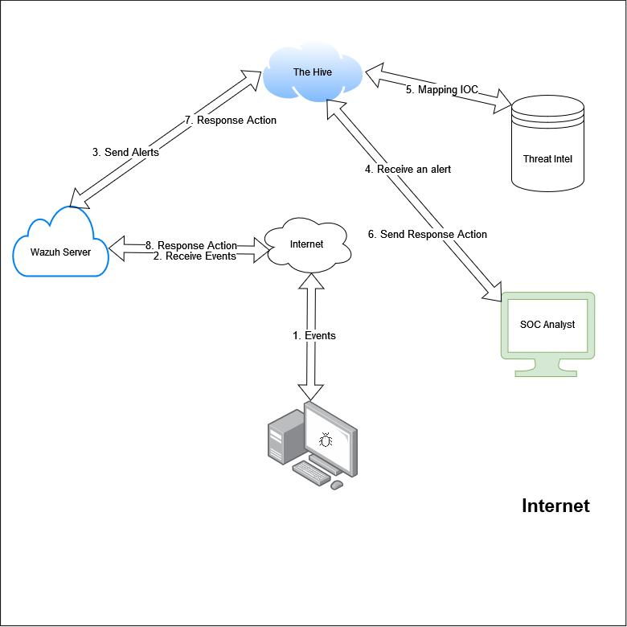
Flow Chart!

Slide 12
Methodology
01
02
03
04
Data Collection and Configuration
Data Filtering and Normalization
Threat Detection and Analysis
Investigation and Response

Slide 13

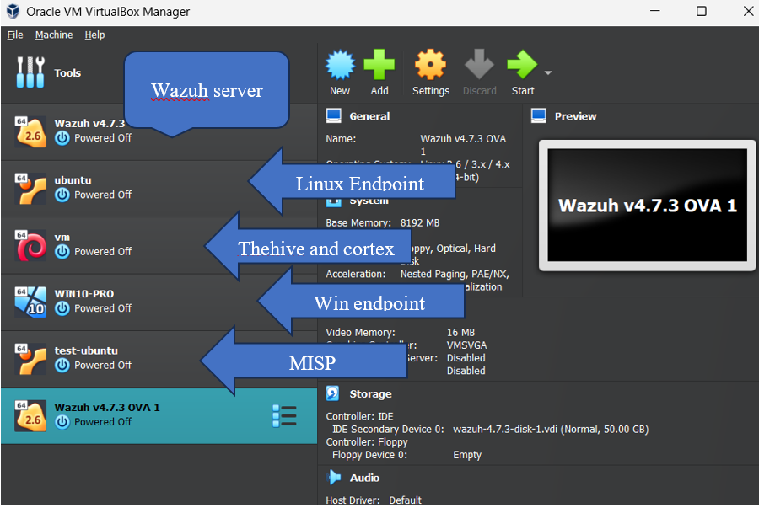
Installation (Environment Setup)

Slide 14
Tools & Technology Used
01
02
03
04
Wazuh
TheHive
Used as SIEM and XDR
Used For Case Management
Threat intelligence
Python and API
Used for getting the intelligence 🧠 from VT, MISP, Cortex, and multivers
Used for the scripting and API integrations

Slide 15


01
Use Cases
Detecting known bad actors with Wazuh and AbuseIPDB

Slide 16



Detecting known bad actors with Wazuh and AbuseIPDB
In this use case, AbuseIPDB assists webmasters, security analysts, and systems administrators in identifying and reporting IP addresses linked to different types of harmful assaults. It offers an API to look for malicious behaviour on an IP address and report it.
Setting up the integrator tool in preparation for a unique integration.
Writing a Python script to handle alerts and compare the IP address in the source log with AbuseIPDB API checks.
Formulating regulations according to the Confidence of Abuse scale.
Identify when a person tries to log in using a non-private IP address; inquire of abuseipdb if the IP address is harmful; and get an answer from AbuseIPDB

Slide 17
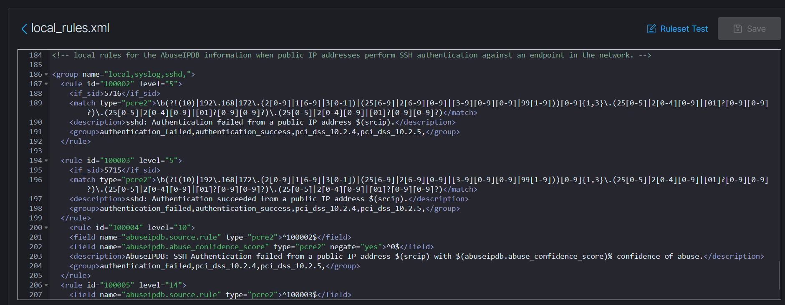
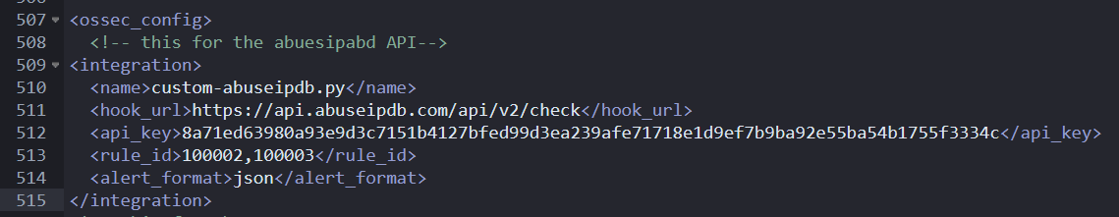
Wazuh local rules
Wazuh Server configuration API endpoint of AbuseipDB For checks ✅

Slide 18
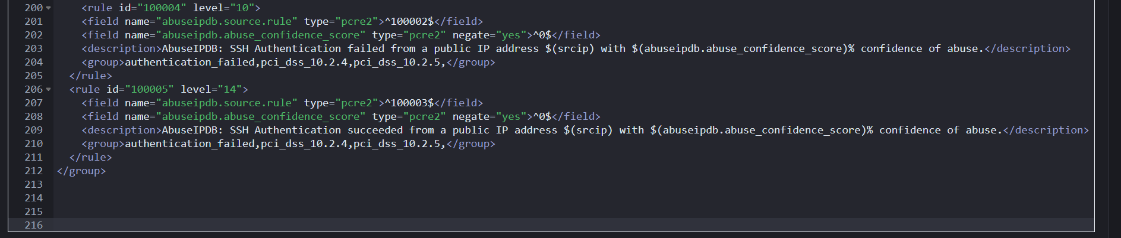
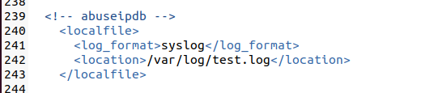
Creating rules with AbuseIPDB information
These rules can be triggered in a test via log injection on an endpoint enrolled to the Wazuh manager.

Slide 19
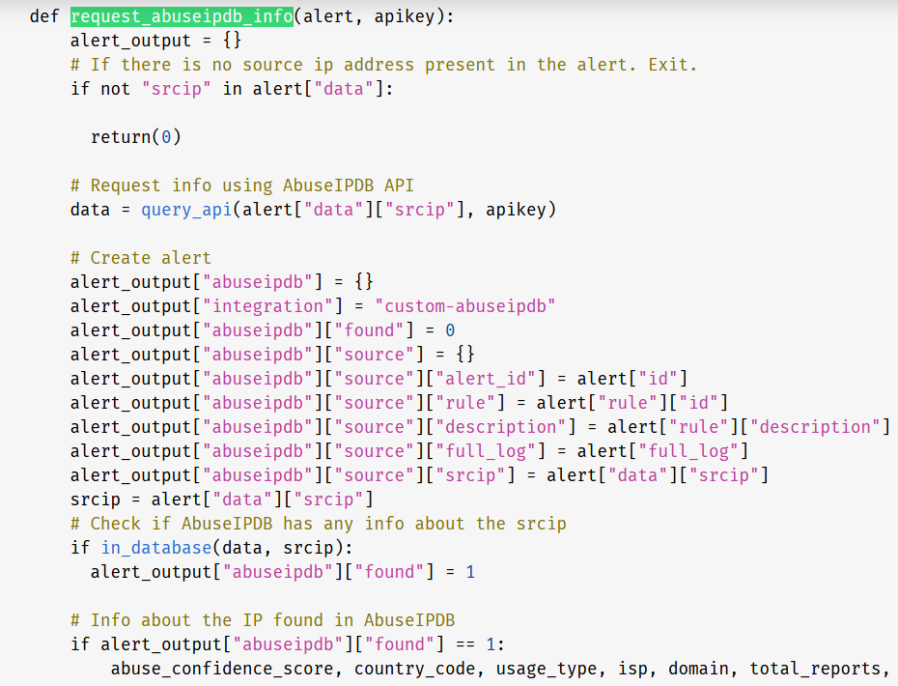
Main python script for integration and check

Slide 20
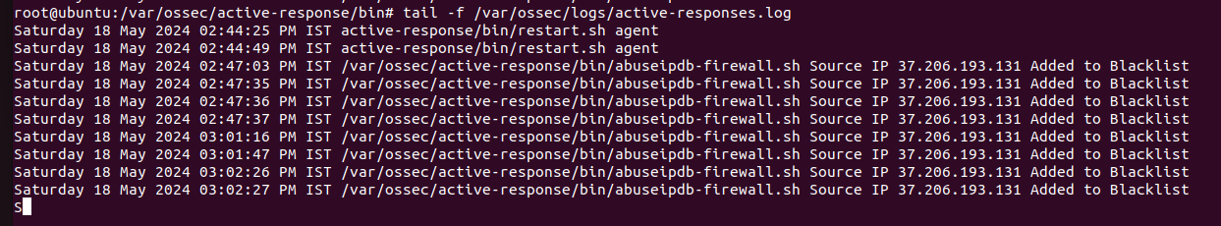
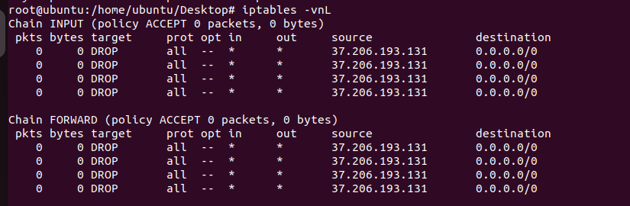
Ip added to the black blacklist
Endpoint firewall drops the blacklisted ip proof concept

Slide 21
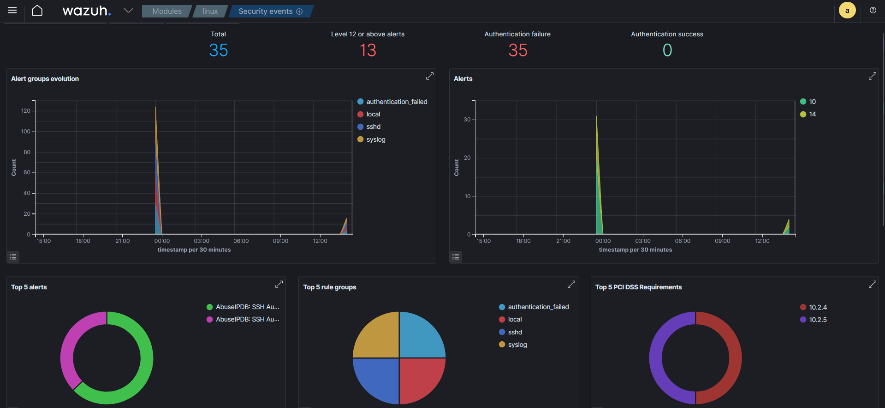
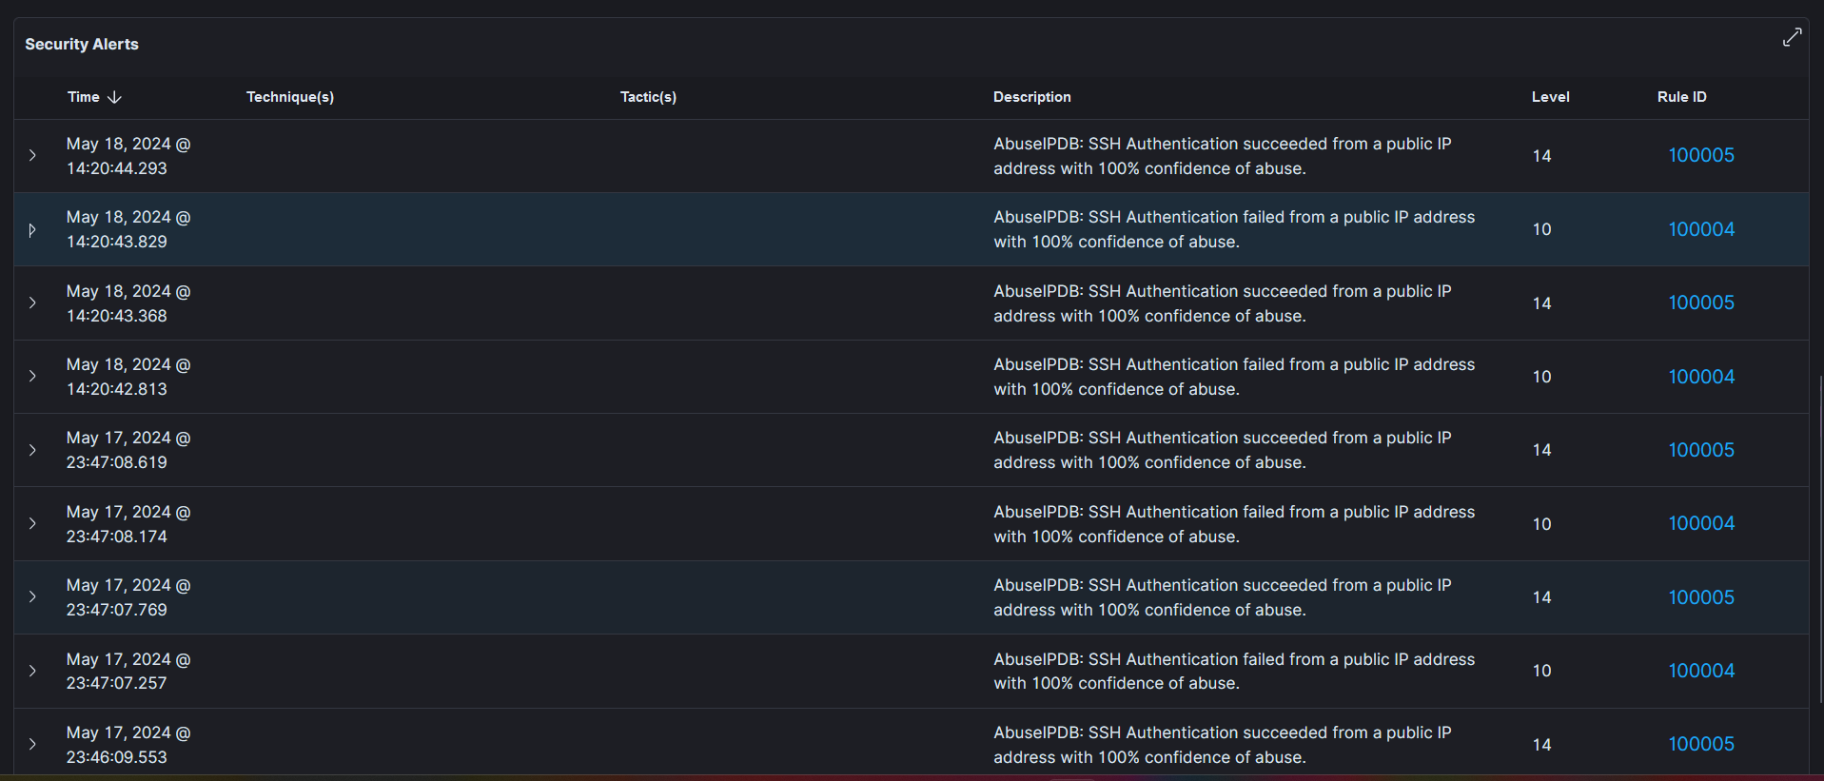
Dashboard

Slide 22
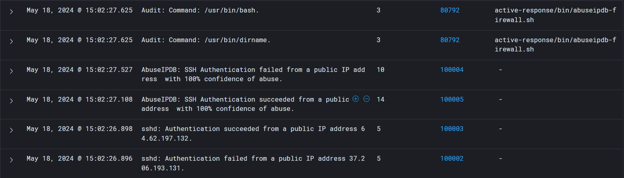
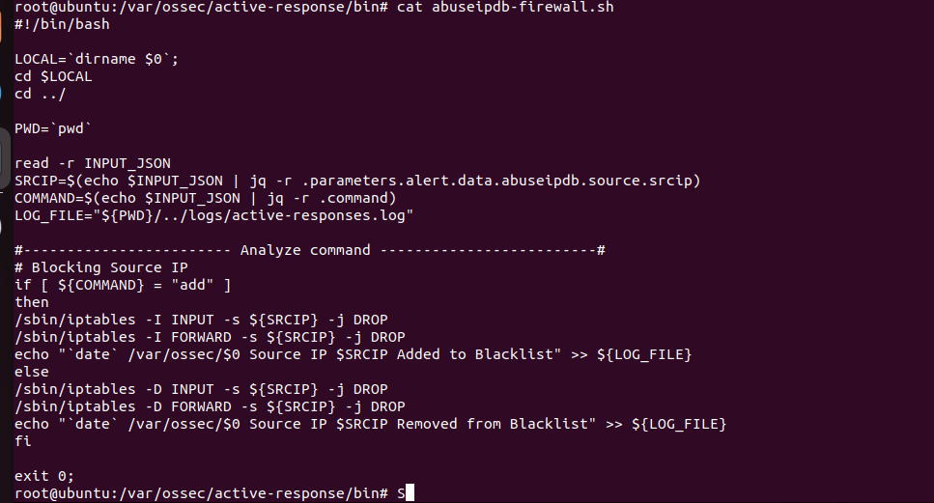
Ips log that balcklist on the abuseIPDB
Endpoint firewall dropping script

Slide 23
02
Use Cases
Blocking SSH brute-force attack with active response

Slide 24
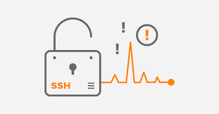

Objective: To automatically block IP addresses that perform SSH brute force attacks after 5 failed attempts using Wazuh Active Response. Overview: Brute force attacks over SSH involve an attacker attempting a number of username-password combinations in an attempt to enter a system. We can identify these attacks and block the offending IP addresses after a certain number of unsuccessful attempts by combining Wazuh with Active Response. Results: Successfully detected and blocked IP addresses after 5 failed SSH login attempts. Enhanced security by automating the response to SSH brute force attacks.

Slide 25
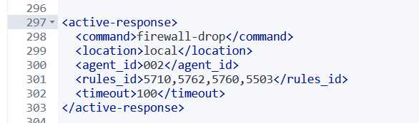
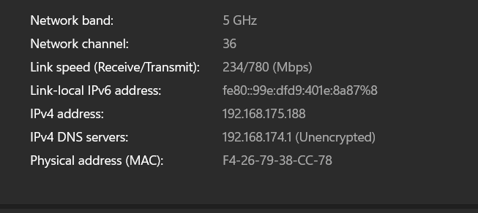
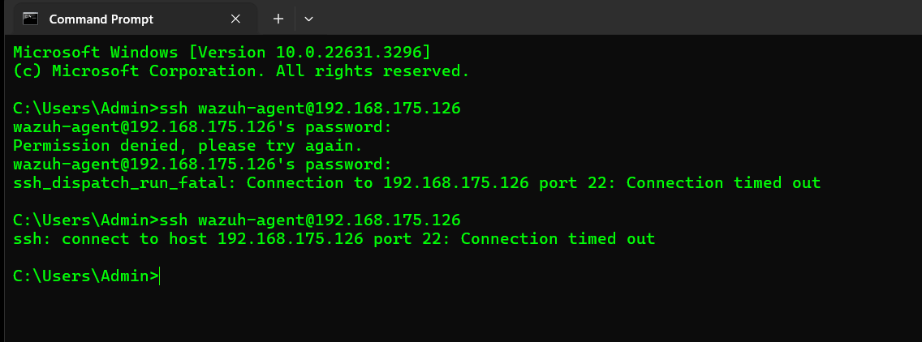
Wazuh manager configuration
Attacker ip
Attack simulation after 2 or 3 attempt the ip waz under balcklisted and connection hase been refused

Slide 26
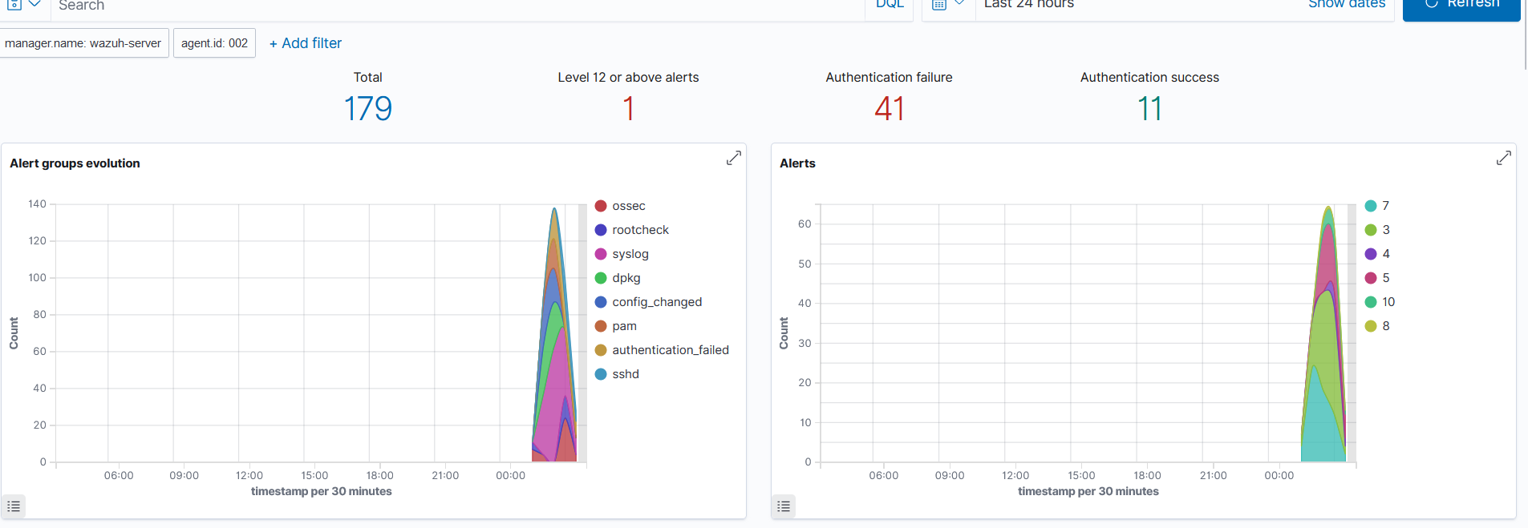
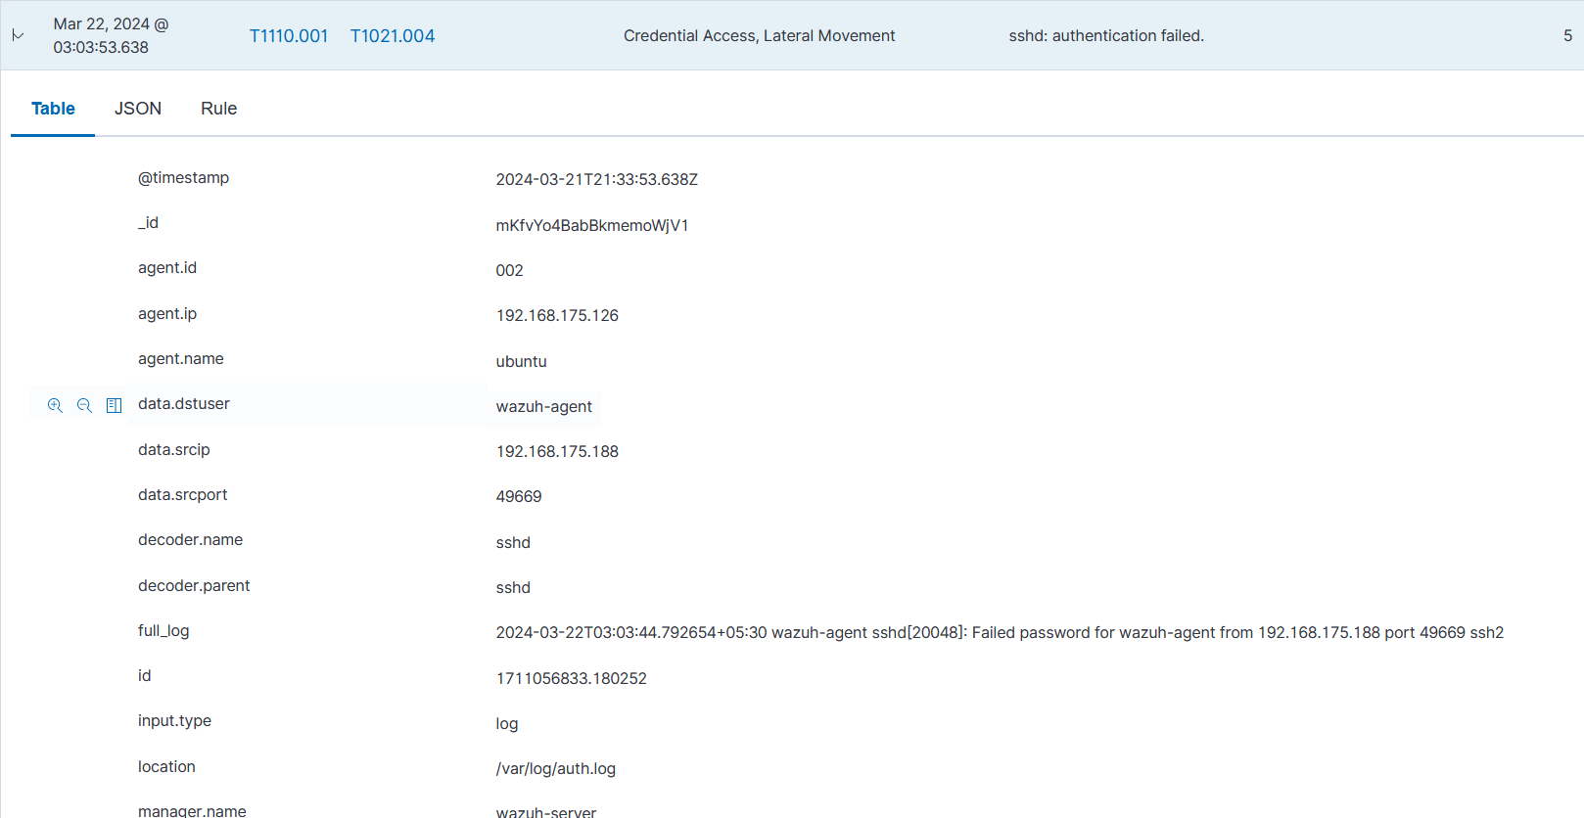
Dashboard
Detail log

Slide 27
03
Use Cases
Automating Malware Detection and Remediation with VirusTotal

Slide 28

Wazuh connects to external APIs and warning systems like VirusTotal using the integrator module.
In this example, a directory is monitored for modifications using the Wazuh File Integrity Monitoring (FIM) module, and the files within the directory are scanned using the VirusTotal API. Next, set up Wazuh to delete files that VirusTotal deems harmful and launch an active response script. We evaluate both Windows and Ubuntu endpoints for this use case.

Slide 29
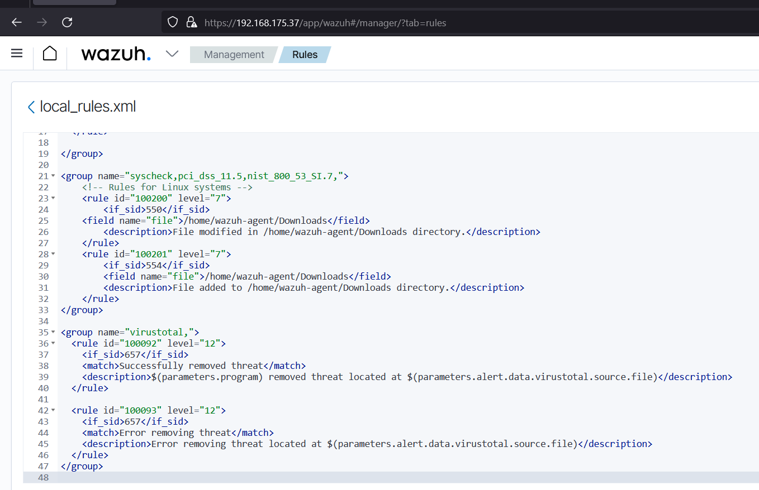
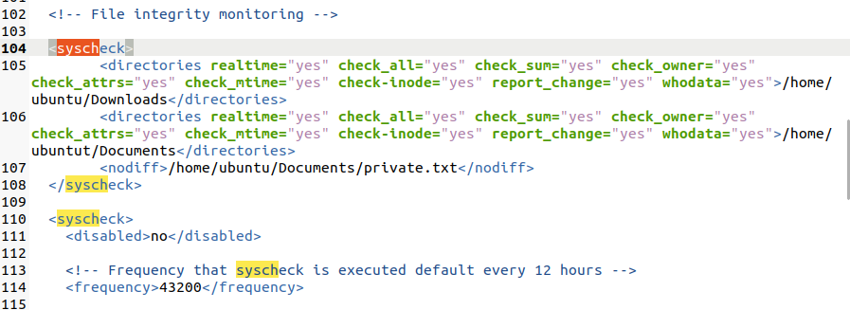
Wazuh local rules config for FIM and VT Response
Local rules for the FIM checks

Slide 30
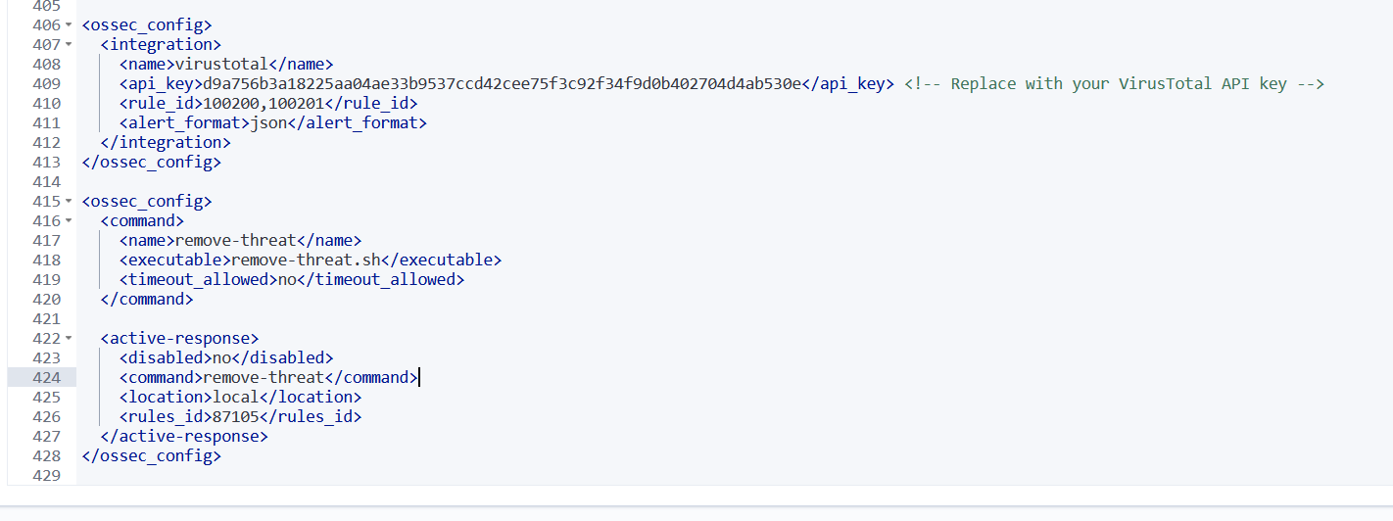
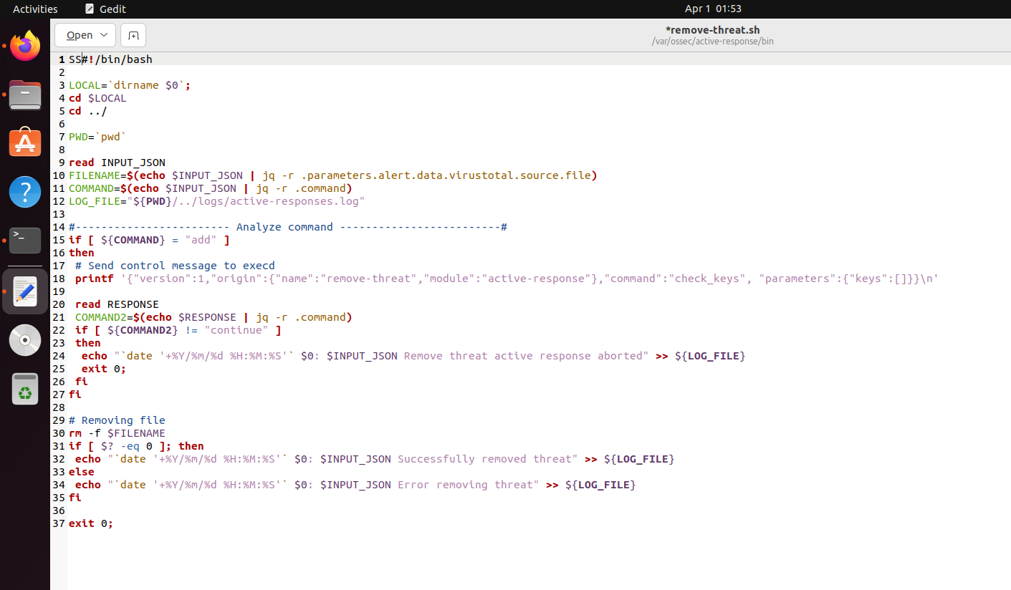
API contion with VT for check the malicious content
Remove.sh scripts for removing file

Slide 31
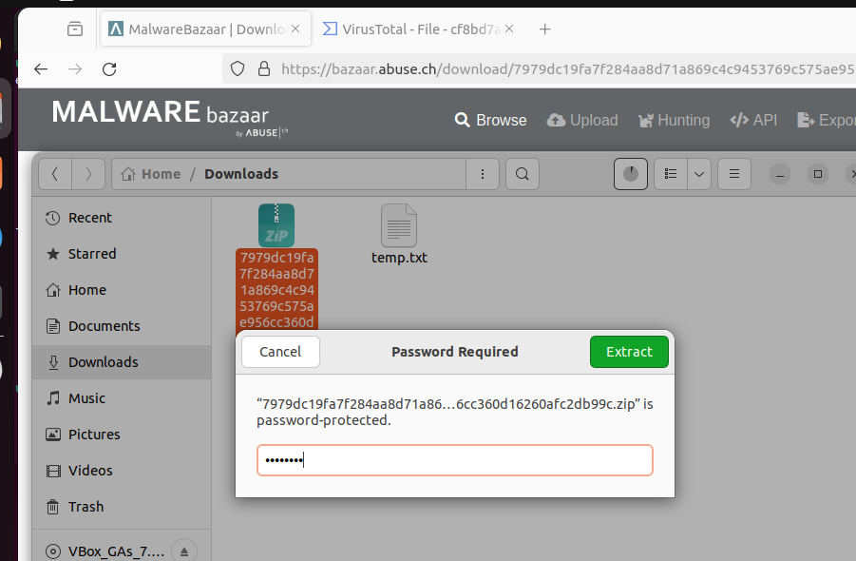
Client view

Slide 32
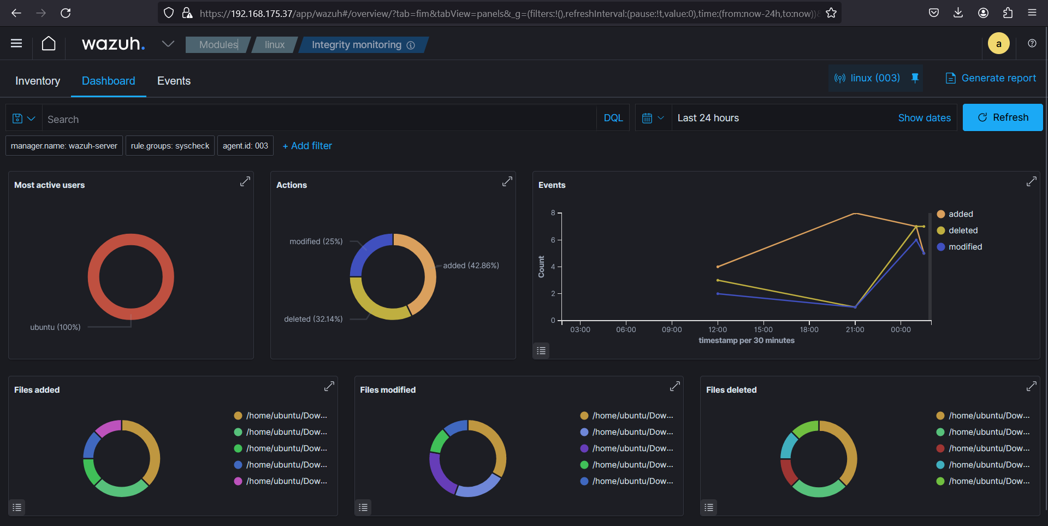
Custom dashborad for FIM Responses

Slide 33
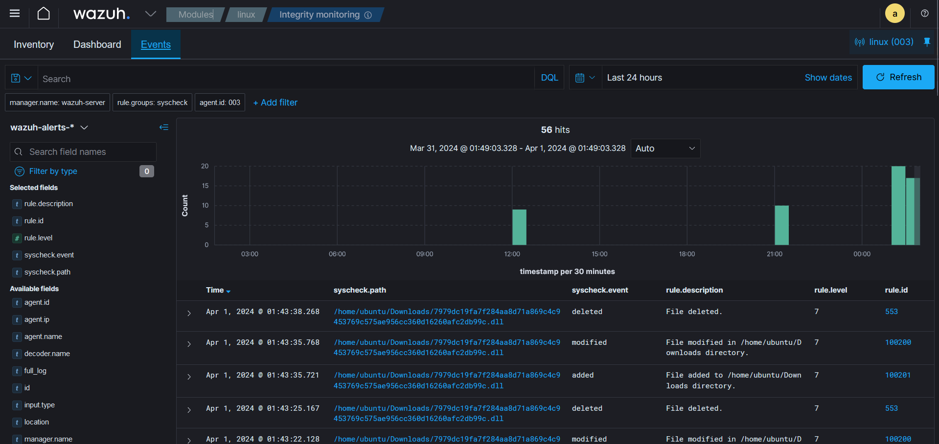

Slide 34
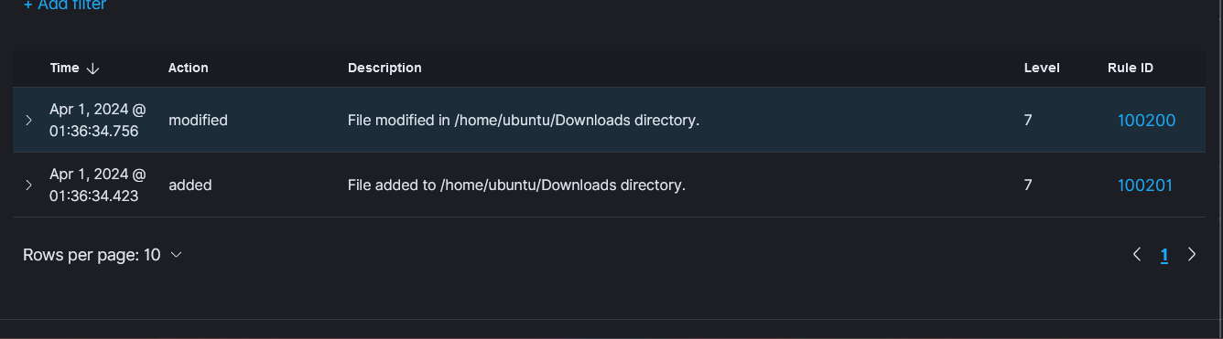

Slide 35
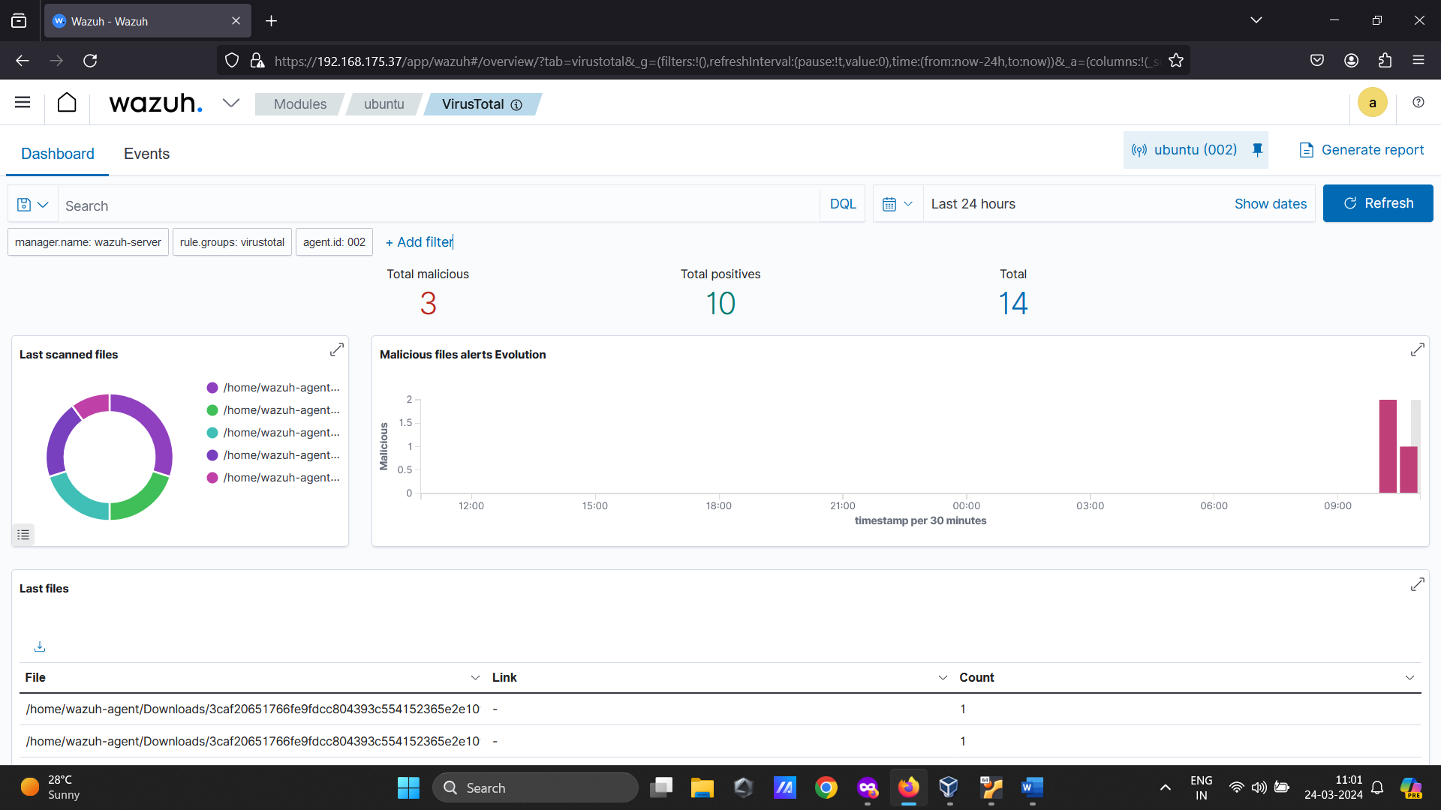
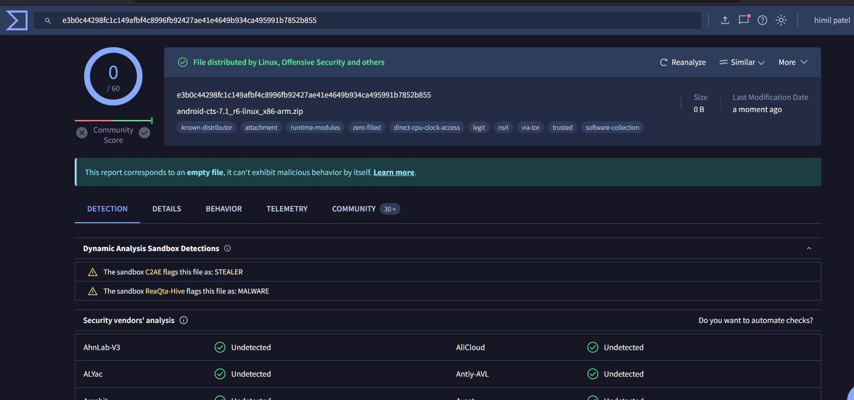
Custom dashborad for VT Responses
Real time Automated VT response

Slide 36
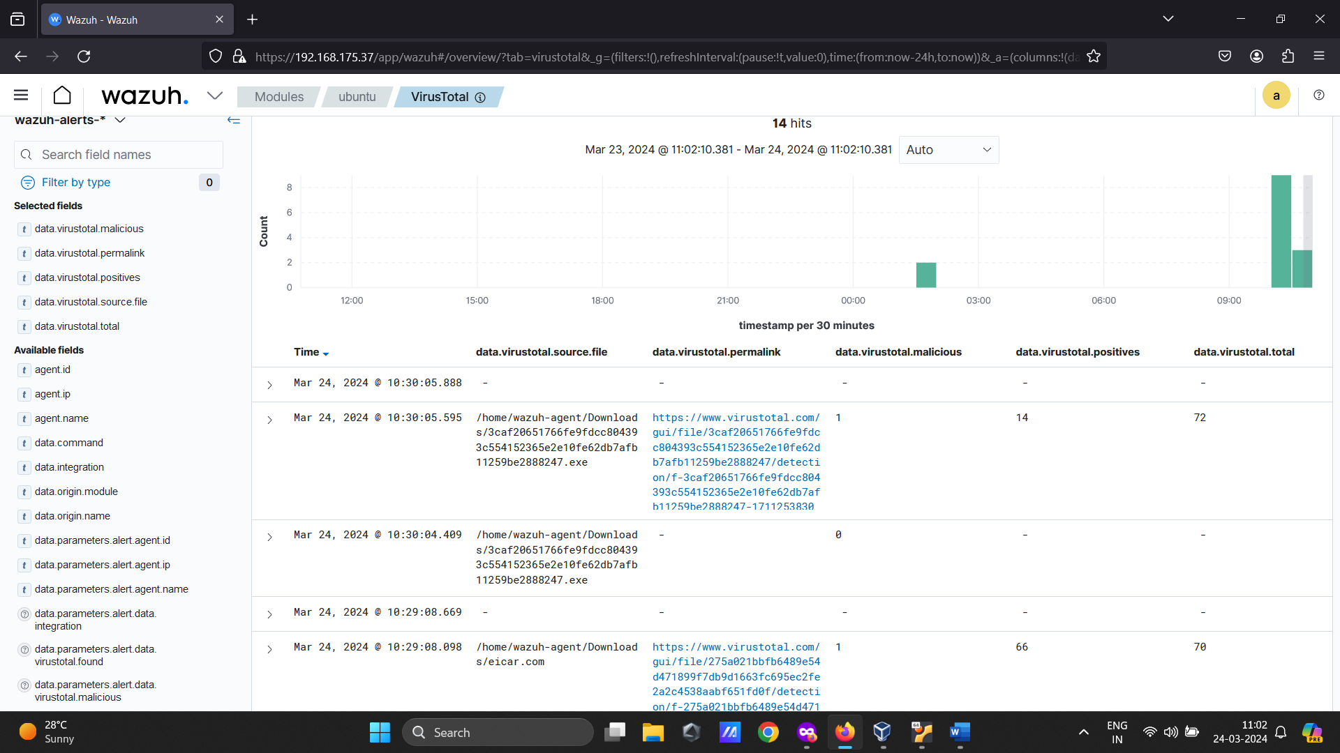
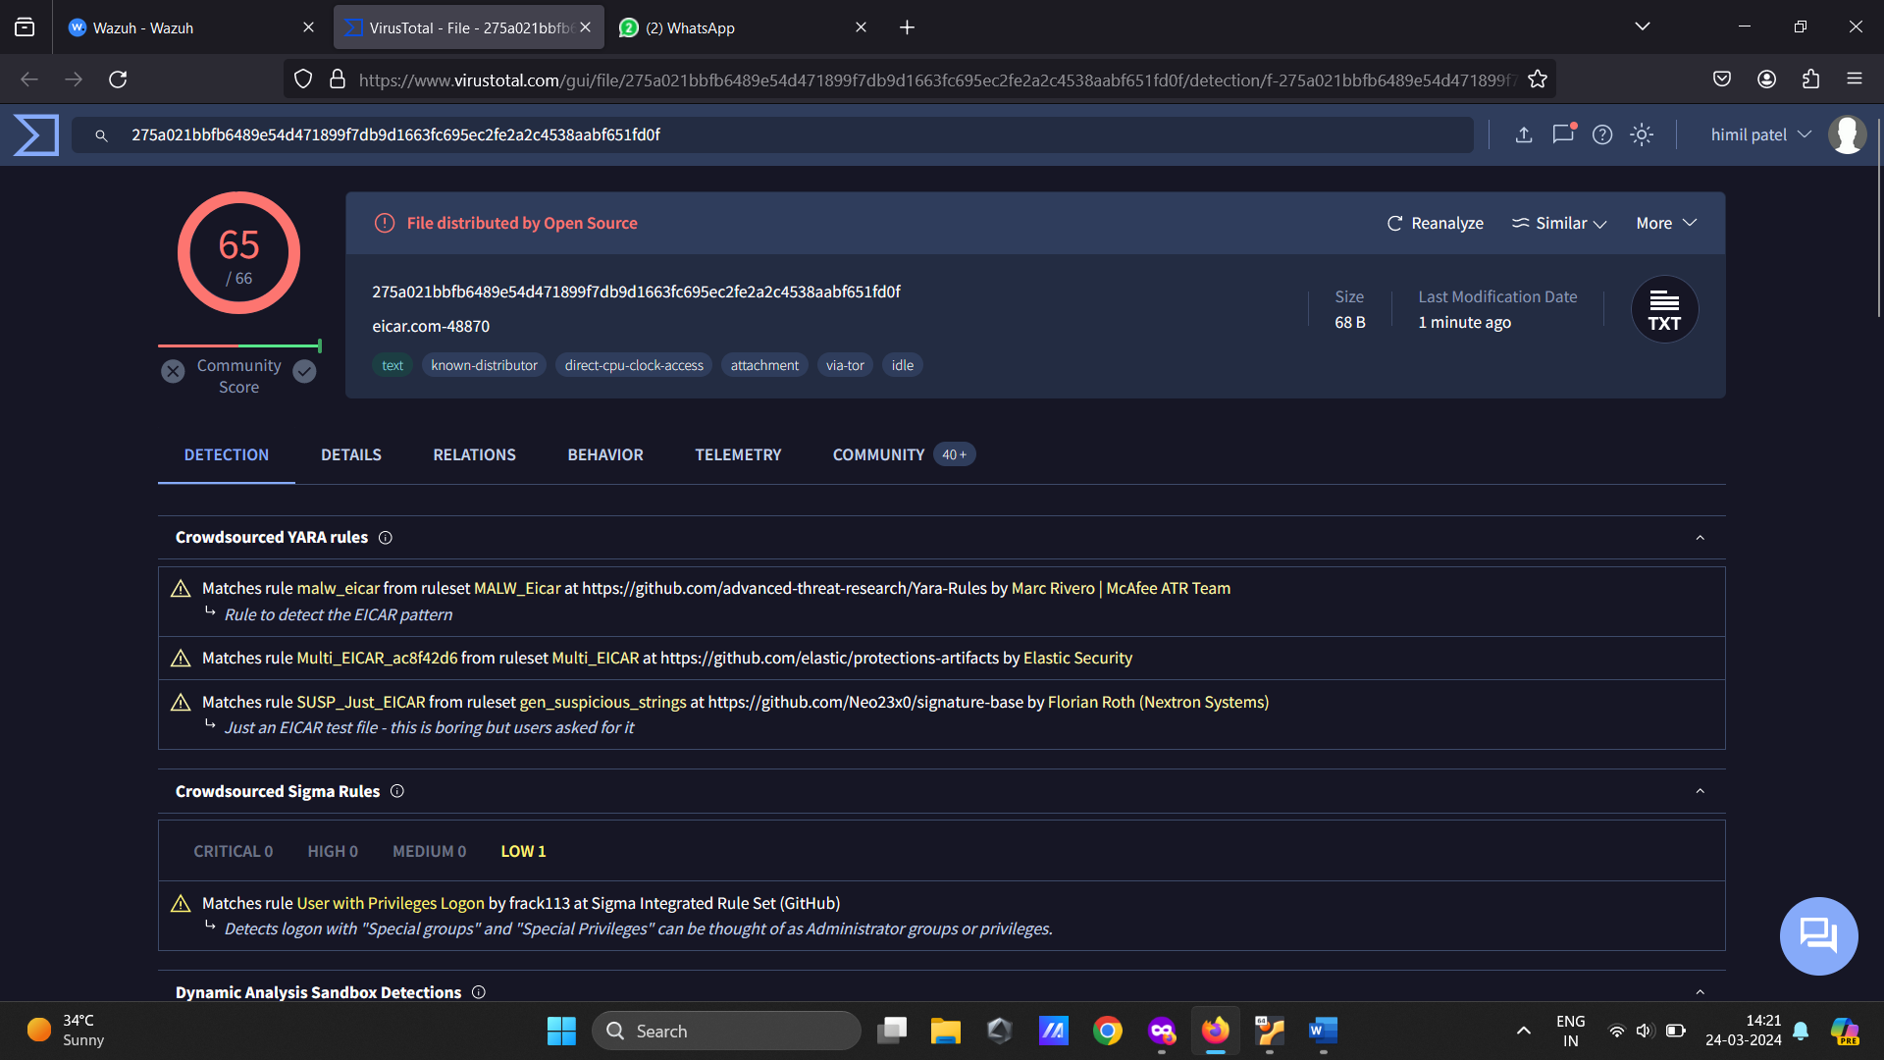
If the malicious file from the VT response then remove.sh file running into the background and the file has been deleted automatically

Slide 37
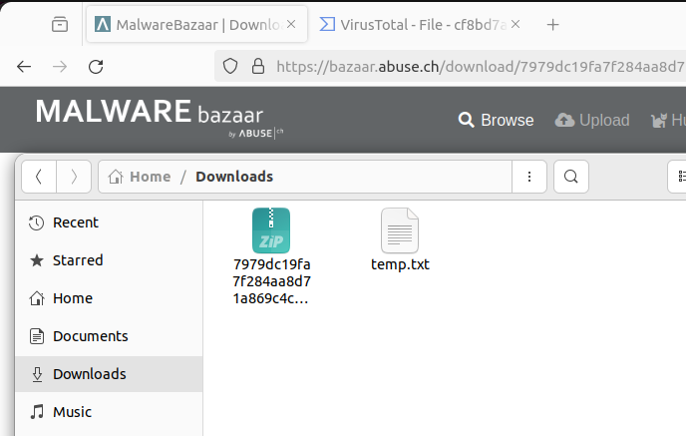

Slide 38
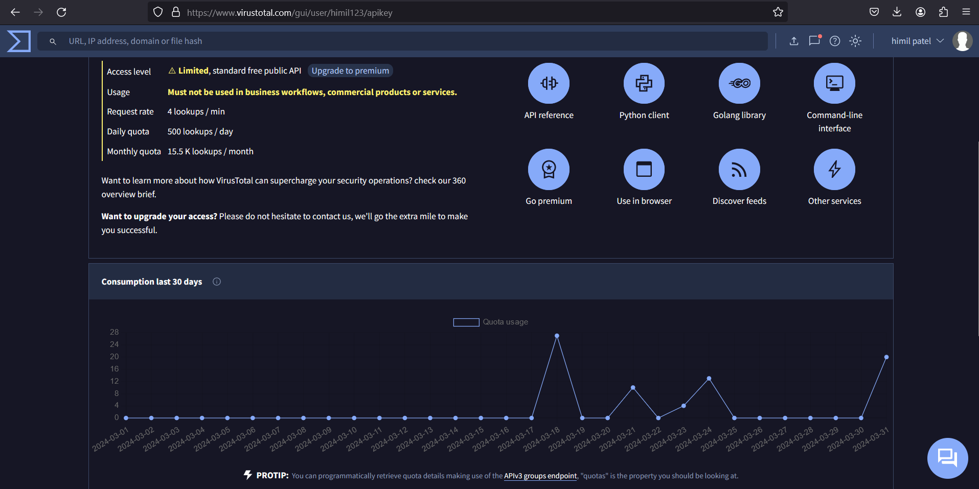

Slide 39
04
Use Cases
Real-time USB Drive Anomaly Detection

Slide 40


On a Linux endpoint, keeping an eye on USB drives is crucial to preserving system security and integrity. USB drives can serve as a potential entry point for malware and unauthorized data access. By monitoring these drives, administrators can detect and prevent the introduction of malicious software or unauthorized data transfers.
Additionally, monitoring USB drives helps in ensuring compliance with security policies and regulations, safeguarding sensitive data, and mitigating the risk of data breaches. It’s a proactive measure that enhances overall system security and protects against potential threats posed by external storage devices.
Out of the box, Wazuh provides a rule to monitor USB devices in Linux endpoints. However, the logs are limited and do not contain enough information about the event, as seen in the image below. Using udev rules, we can get richer logs about USB events In this section, we configure the Ubuntu endpoint to utilize the udev utility to generate enhanced logs when a USB drive is connected to the endpoint. We also configure custom rules and a CDB list on the Wazuh server, enabling it to trigger an alert when an unauthorized USB device is connected to the Ubuntu endpoint

Slide 41
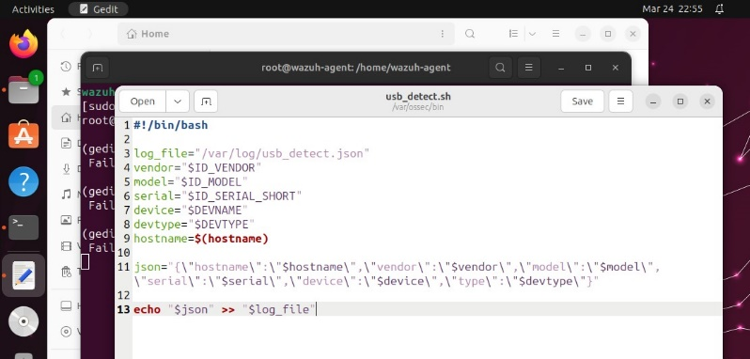
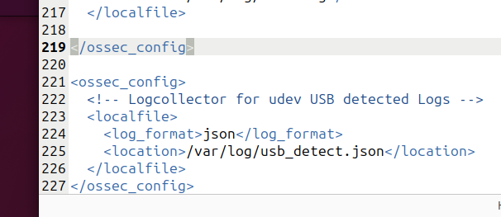
USB Detection Script
Agent side configuration

Slide 42
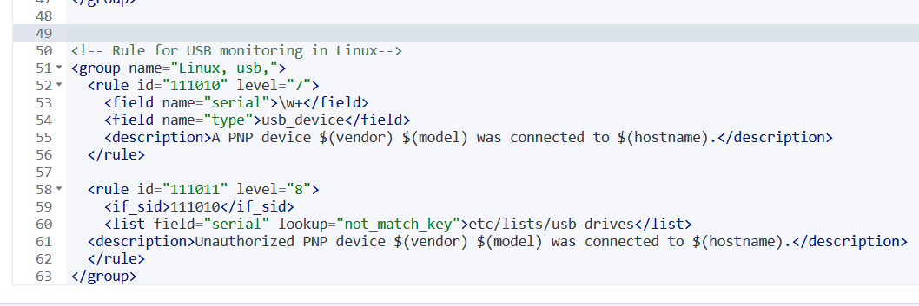
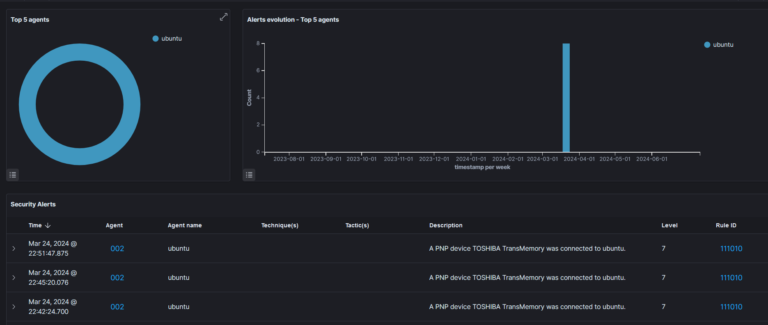
Local rules of the wazuh
Custom dashboard for USB logs

Slide 43
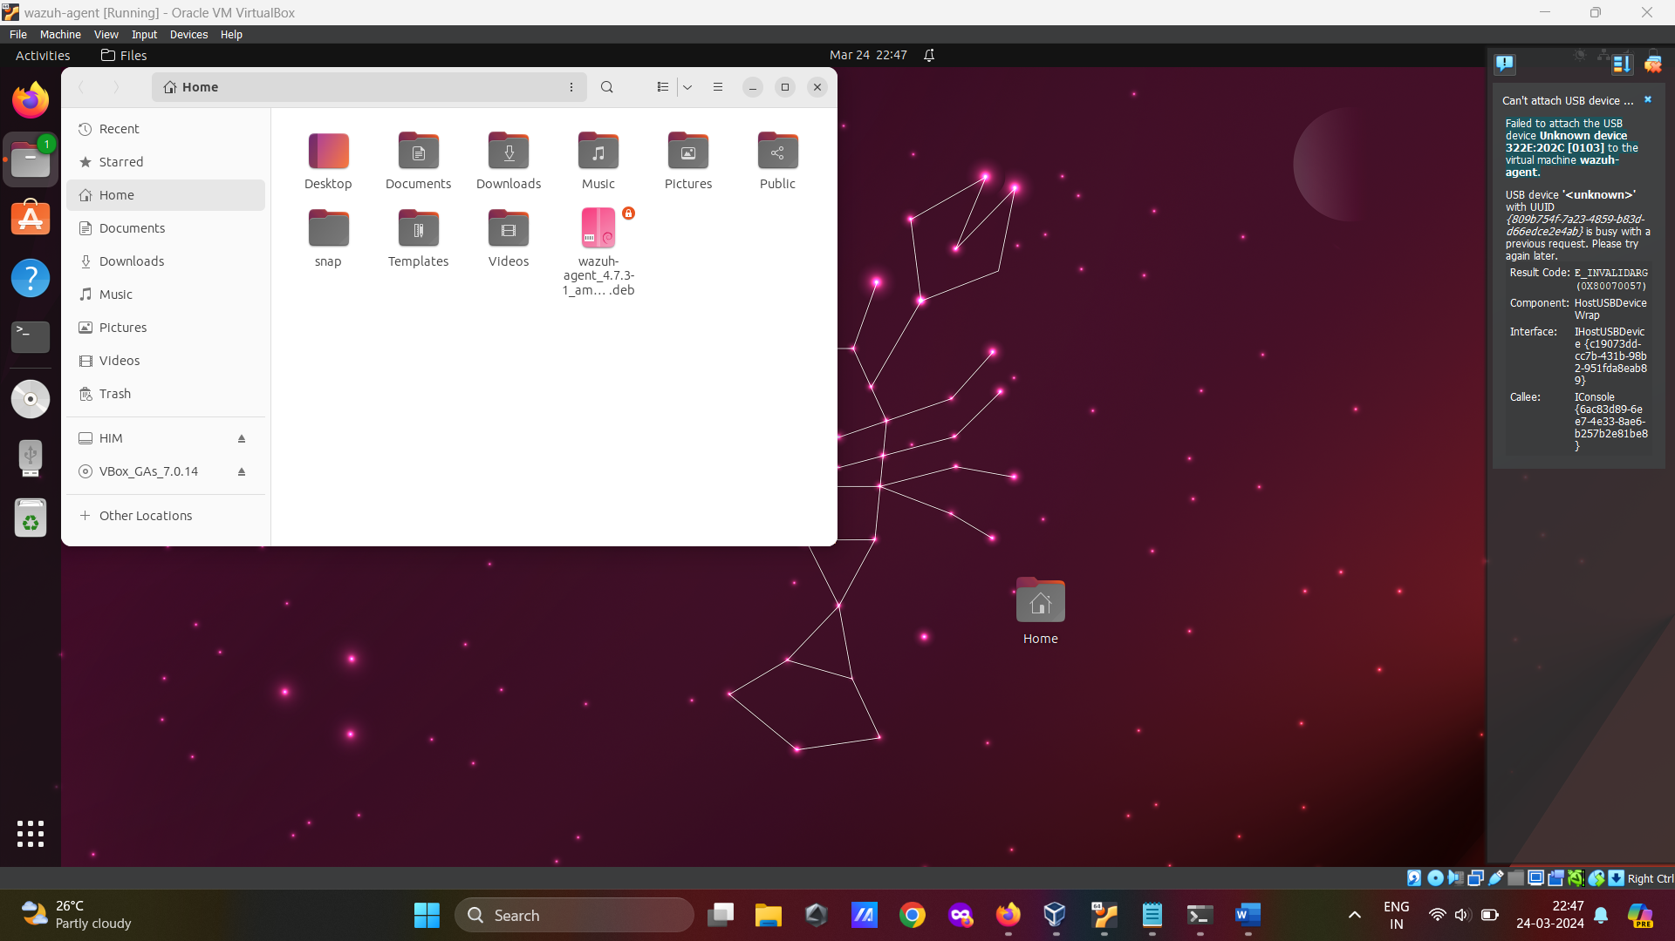

Slide 44
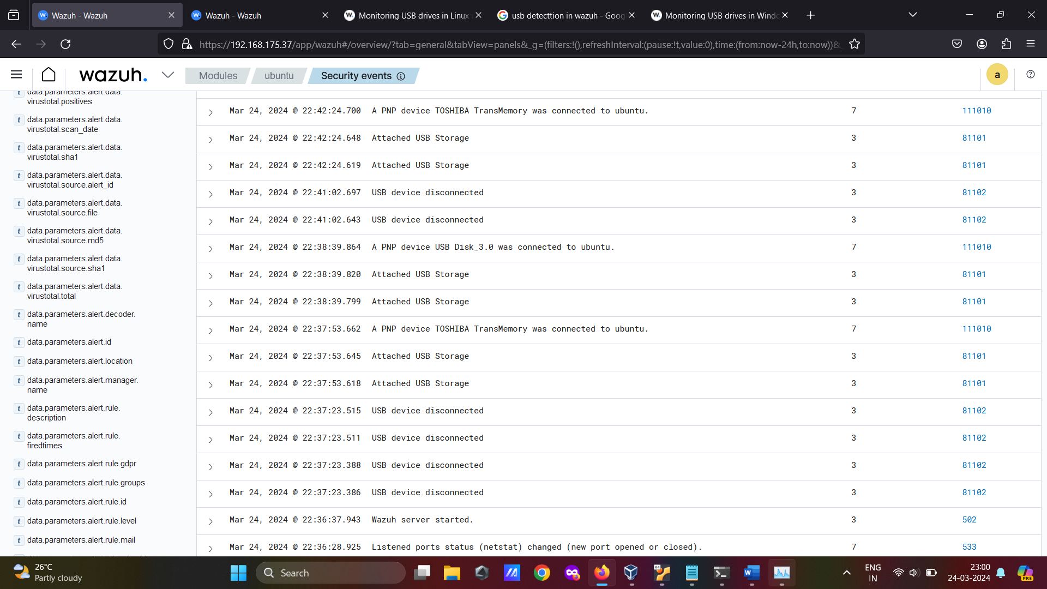
Logs on wazuh

Slide 45
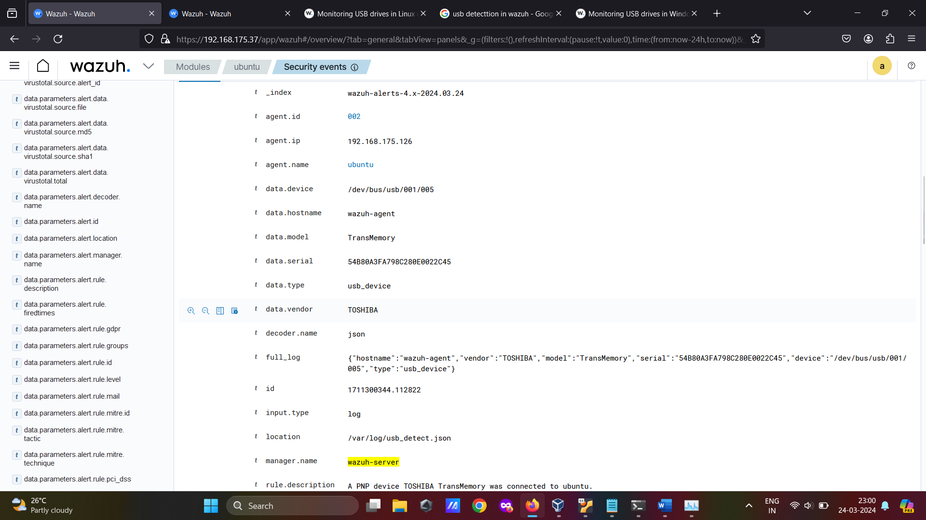
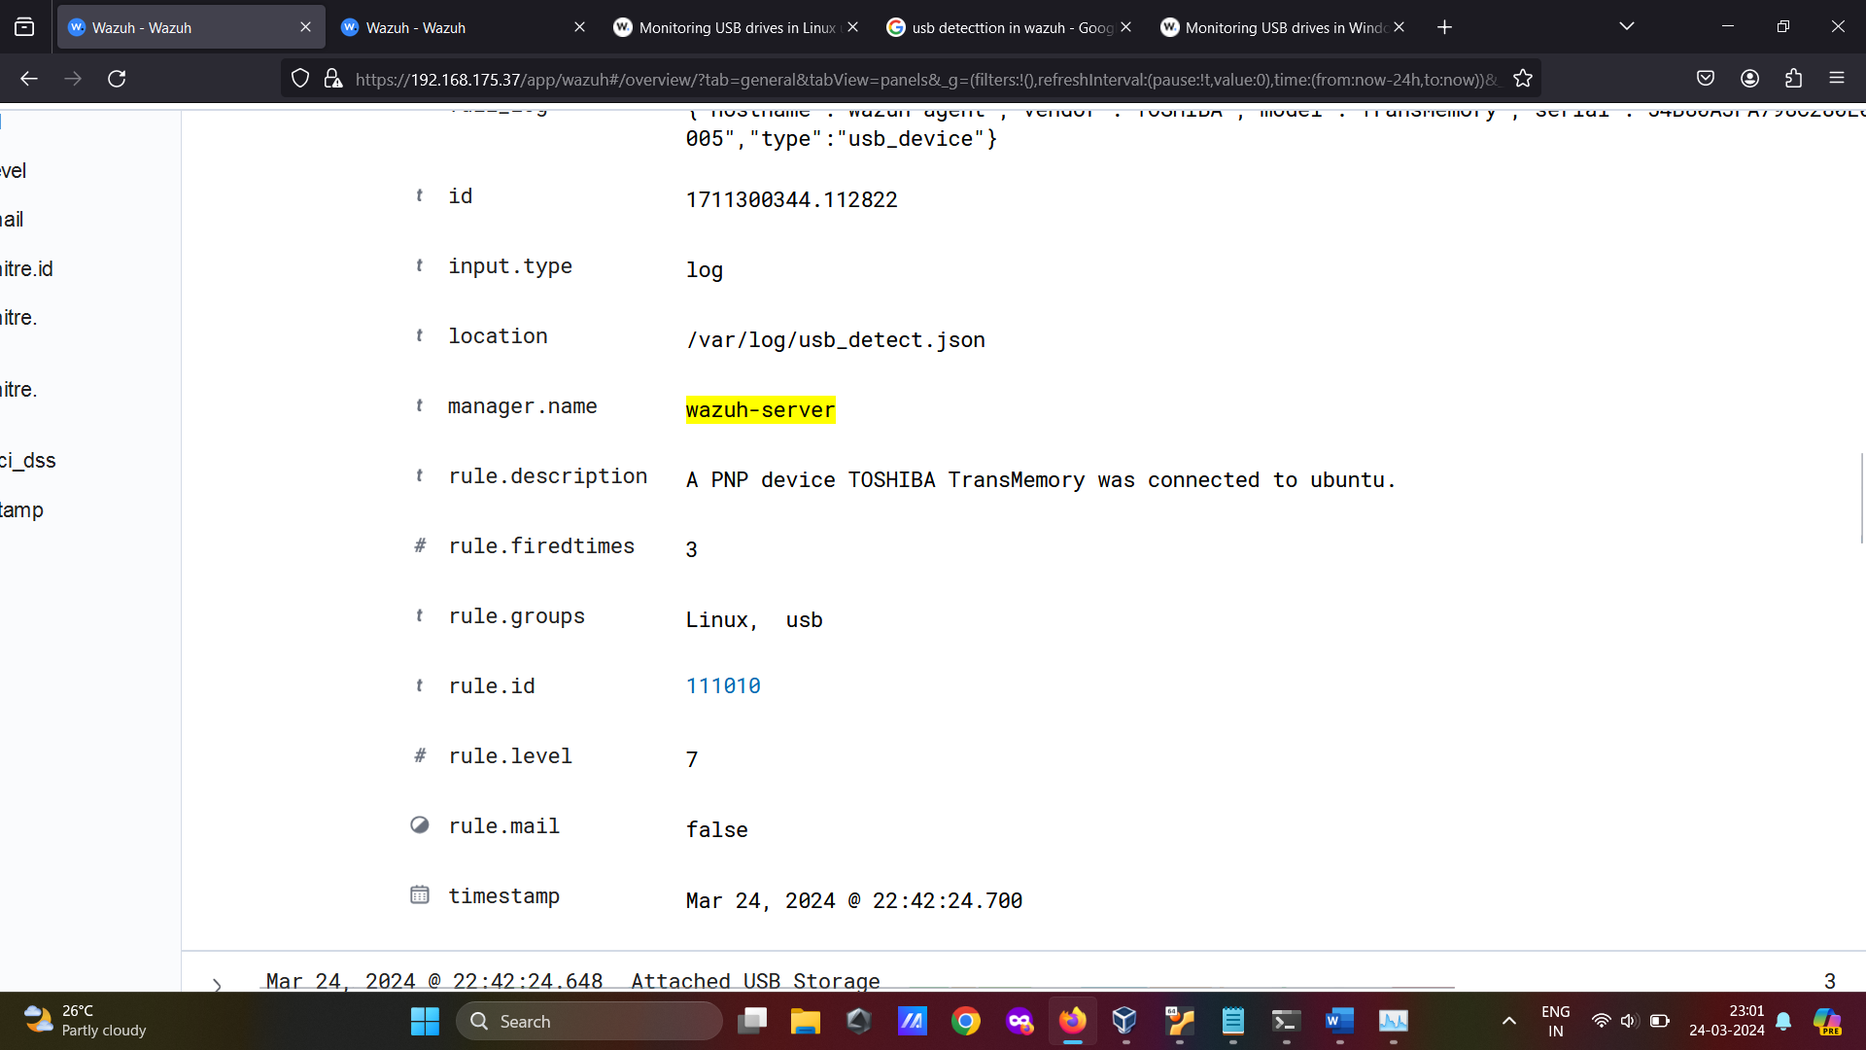

Slide 46
05
Use Cases
Restricting Unauthorized Software Usage

Slide 47

Scope:
This report outlines the implementation of an automated software blocking policy using PowerShell 7.0, Wazuh, and Sysmon. The focus is on enhancing security measures within the organization by identifying and blocking unauthorized software installations and executions.
Objective:
The primary objective is to establish a robust, automated mechanism to detect and block unauthorized software on organizational systems. This is achieved by leveraging the capabilities of PowerShell 7.0 for scripting, Wazuh for monitoring and alerting, and Sysmon for detailed event logging.
Purpose:
This policy's goal is to stop malicious or unauthorised software from causing security breaches. Our goal is to lower the risk of malware infections, data breaches, and other security issues by automating the detection and blocking process.
Importance:
Enforcing an automated software blocking strategy is essential to preserving organisational systems' security and integrity. Unauthorised software can cause serious data loss or theft, present vulnerabilities, and interfere with operations. An efficient policy makes sure that only authorised software is run, improving the organization's overall security posture.
Explanation: How it Working
We can install sysinternal on the end point so that with the help of the sysmon we can get the more pro-active log details based on that we can set the rules in siem tools for detection
example like event:1 is used for process creation means any application is started or open by the user based on that event 1 we can check the company name of that application is allowed on the cbd list or not base on that allied application are run and this checking is done by the siem

Slide 48
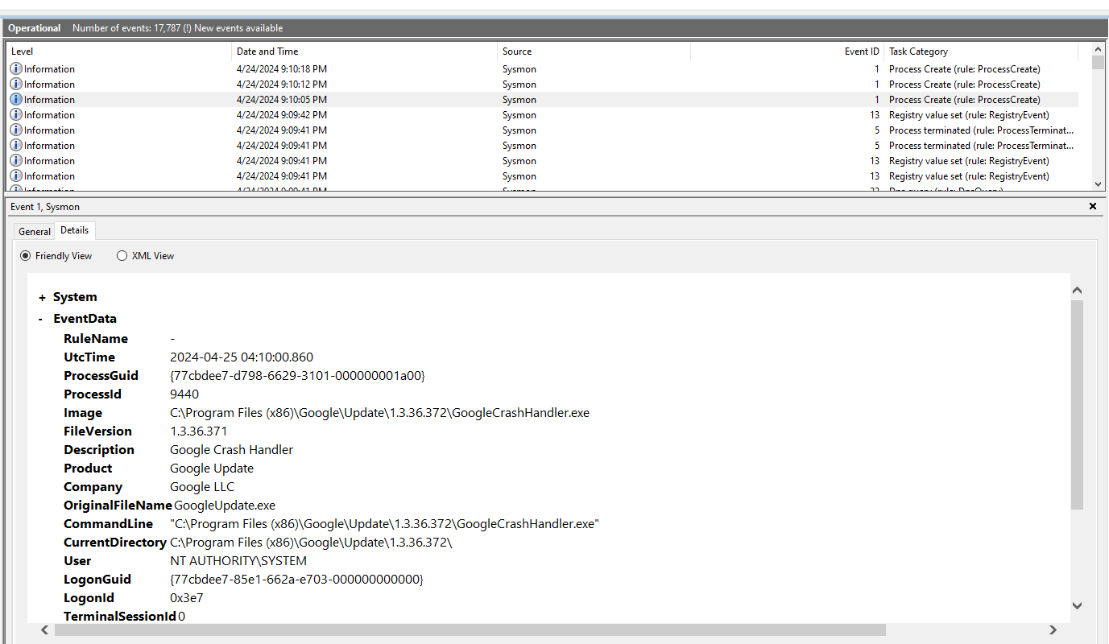
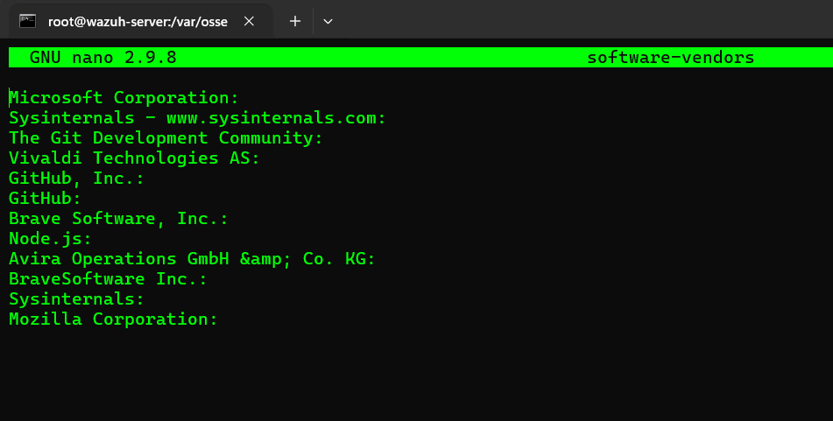
Sysmon logs and based on events
Whitelisted software google chrome has been not mentioned means it is blacklisted

Slide 49
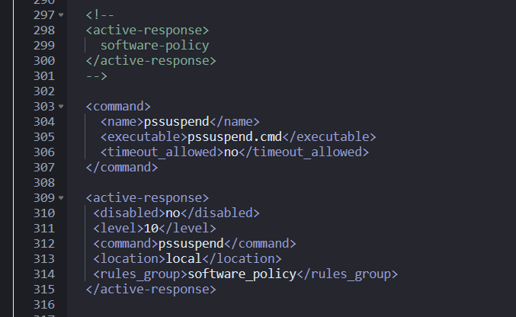
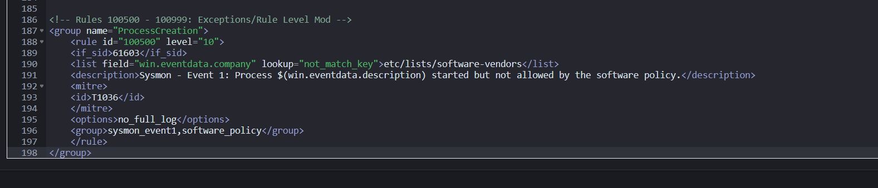
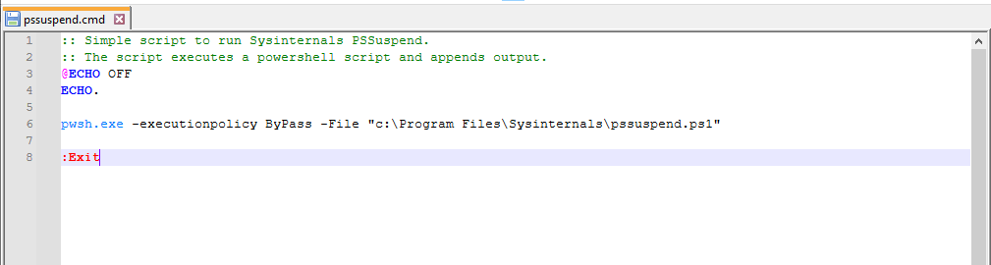
Wazuh server config for active response on bad software running process
Wazuh local rules
active response script on bad software running process

Slide 50
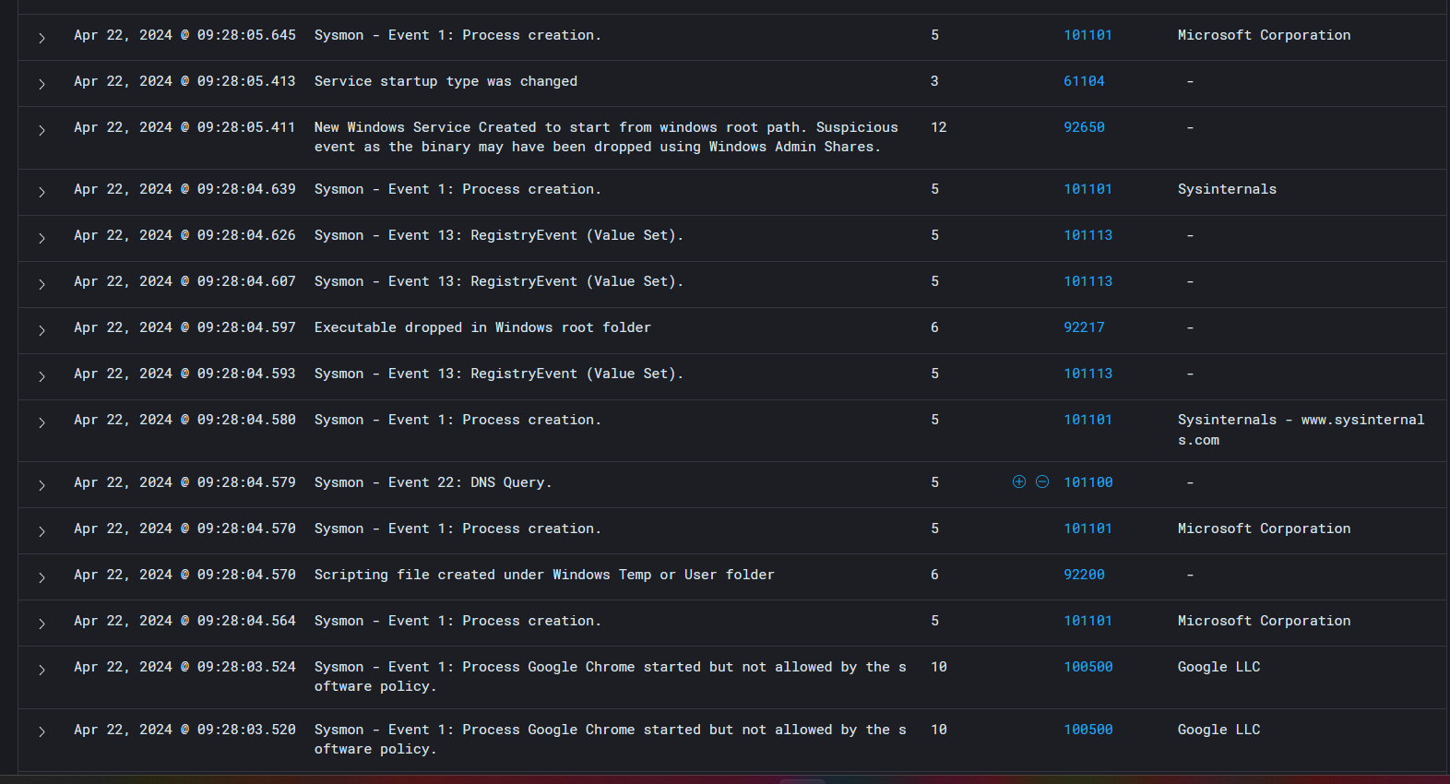
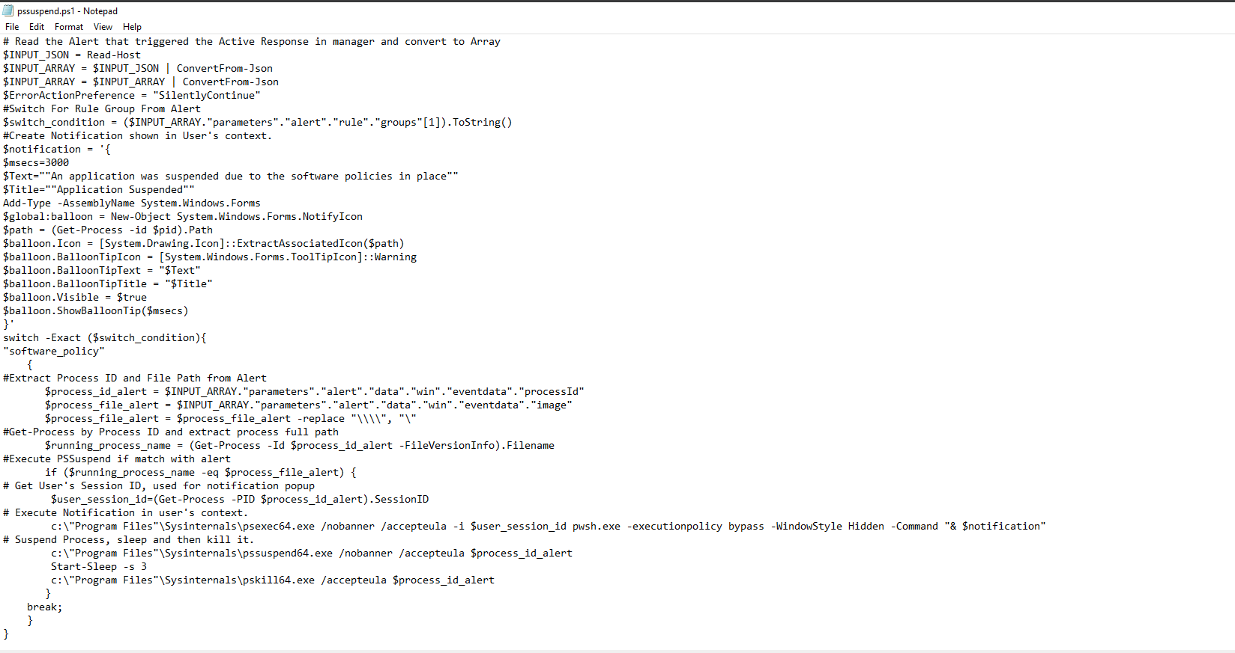
Active response script on endpoint side
Wazuh logs

Slide 51
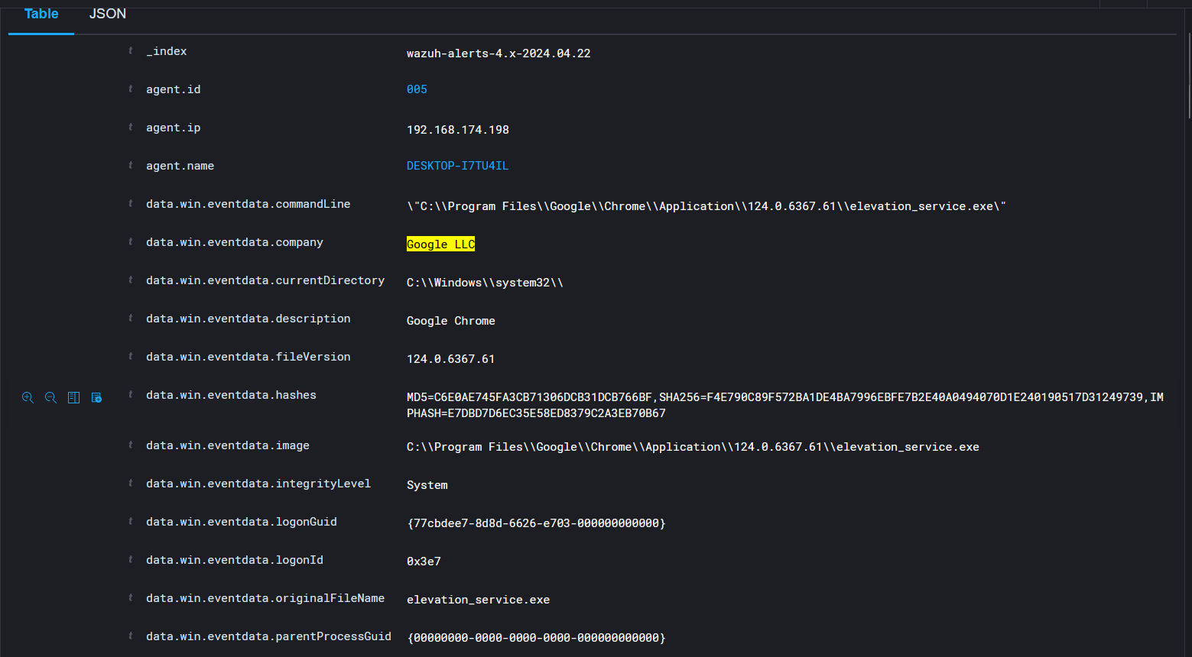
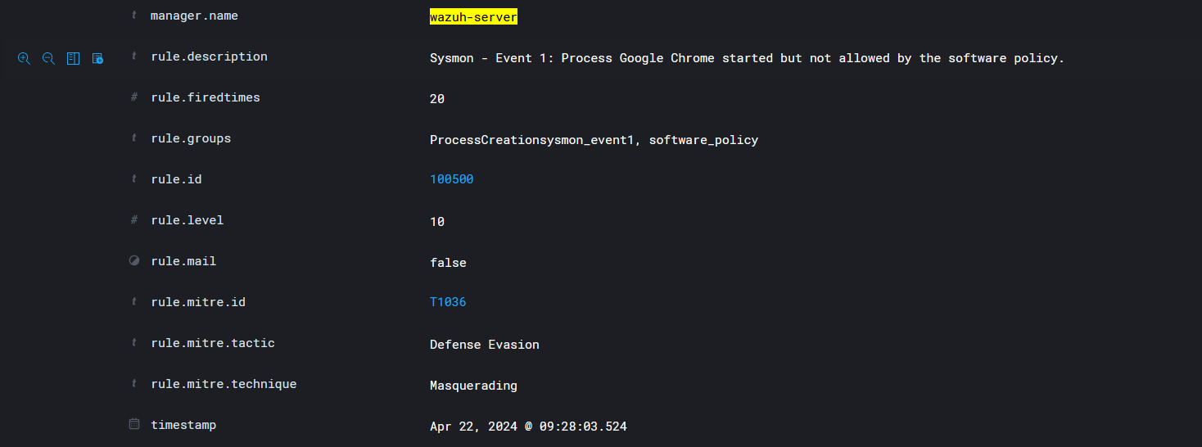

Slide 52



Slide 53
06
Use Cases
Automated File Quarantine Using YARA Rules

Slide 54

Scope: This study describes how to use YARA rules to construct a system that can identify and quarantine dangerous files that are uploaded to a web server. The system's goal is to improve the web server's security by locating and separating potentially dangerous files before they have a chance to do any harm. Goal: The main goal is to develop an automated system that uses YARA rules to check uploaded files to the web server for harmful content. A questionable file will be quarantined if it is found in order to stop it from running or propagating. This project's goal is to safeguard the web server against malicious files that can cause data loss, disruptions in service, or security lapses. Through the analysis of file contents utilising YARA rules, the system can
This project's goal is to safeguard the web server against malicious files that can cause data loss, disruptions in service, or security lapses. The system can detect known patterns of harmful behaviour and quickly quarantine suspect files by utilising YARA rules to analyse file contents.

Slide 55



Attack simulation

Slide 56




Slide 57


Custom dashboard and yara rules script for check the file

Slide 58
07
Use Cases
Streamlining Security IRThrough Telegram Integration and Real-Time Alerts

Slide 59

Objective The goal is to create a real-time alarm system that uses Telegram to notify administrators when a password-breaking attack is detected on any system in the company via the telegram bot Scope:
The system tracks network activity and login attempts in all systems used by the organisation, identifies any password-breaking assaults, and instantly notifies a specific Telegram channel with the IP address of the compromised device.

Slide 60


API integration with telegram for the real time IR alert base on the severity

Slide 61


API Integration n the Wazuh server side so that it will send the alert on the telegrams via API

Slide 62
Benefits:
Immediate Response: Real-time alerts enable administrators to take swift action to mitigate potential threats.
Enhanced Security: Continuous monitoring and prompt notifications help in quickly identifying and responding to password-breaking attacks.
Automation: The system automates the detection and alerting process, ensuring consistent and reliable notifications.

Slide 63
08
Use Cases
Docker container security monitoring with Wazuh

Slide 64

Docker has gained popularity as a framework for deploying applications because of its advantages. It facilitates, for instance, the augmentation of applications' portability and operational robustness within organisations
● The attack surface for organisations has grown due to the growing use of containerised software. Cyber threat actors now have another resource to aim their attacks against. For this reason, it is essential to keep an eye on containers at all times in order to fully see their execution environment and events
• Track Docker events, including create, start, connect, mount, exec_start, detach, die, exec_create, exec_detach, and so on. • Keep an eye on the use of CPU, memory, and network traffic in Docker containers. • Recognise when memory and CPU use inside containers surpass predetermined limits. • Keep an eye on the uptime and health of Docker containers.

Slide 65


Rule set for the grab the docker health information from the agent side

Slide 66

make temp stress on the container

Slide 67



Alert visualization creating the custom dash bord for all checks into visualizations

Slide 68


Docker container activity logs

Slide 69
09
Use Cases
Real-Time Vulnerability Management for Containers

Slide 70

Protecting containers and the infrastructure that supports them can be achieved by doing container vulnerability scans. Applications can run in isolated settings with containers, which preserve platform consistency. One of the most important proactive security practices is using container vulnerability scanning to identify and fix security risks within containers. Given the dynamic nature of software and the corresponding security threats, this is crucial in preventing bad actors from taking advantage of it.
A software security platform called Snyk assists developers and organisations in identifying and resolving vulnerabilities in their apps and open source dependencies. To fix container vulnerabilities, it features a Command-Line Interface (CLI). In order to find potential security problems, it ensures a rigorous evaluation of container images, libraries, and dependencies through the use of extensive container vulnerability scanning. Container security is strengthened in a variety of contexts by this proactive security approach.
Organisations can greatly reduce the risk of security breaches and improve the overall security posture of their containerised environments by implementing a strong strategy for container vulnerability assessment by combining the capabilities of the Snyk CLI and Wazuh.

Slide 71


Snyk rules configuration in local rules file
Authenticating the Snyk CLI with your Snyk account – synk web

Slide 72

Critical severity alerts
1. Navigate to the Security events tab and input the Dashboards Query Language (DQL) rule.id:111161 in the HTML form. Next, click the update/refresh button to view the critical severity alerts:

Slide 73

High severity alerts
1. Navigate to the Security events tab and input the Dashboards Query Language (DQL) rule.id:111162 in the HTML form. Next, click the update/refresh button to view the High severity alerts:

Slide 74

Medium severity scans alerts
1. Navigate to the Security events tab and input the Dashboards Query Language (DQL) rule.id:111163 in the HTML form. Next, click the update/refresh button to view the Medium severity alerts:

Slide 75

Low severity alerts
1. Navigate to the Security events tab and input the Dashboards Query Language (DQL) rule.id:111161 in the HTML form. Next, click the refresh button to view the Low severity alerts:

Slide 76
10
Use Cases
User Command Activity Monitoring in Linux

Slide 77

Objective:
To implement a robust monitoring system that tracks every command executed by users on a Linux system and logs this activity into Wazuh for comprehensive visibility and auditing.
Purpose:
The purpose of this implementation is to enhance security by closely monitoring user activities on the command prompt. By logging all commands to Wazuh, we can track and analyse user behaviour, detect unauthorized actions, and maintain an audit trail for compliance and forensic investigations.

Slide 78


Audit installation and configuration on the end points

Slide 79


Custom Audit dash board based on this time line we can track down the user activity on terminals also

Slide 80


At which location, what time, what command, which user can executed a command we can track
down over here

Slide 81
11
Use Cases
Detecting web attacks using Wazuh and teler

Slide 82

Wazuh is an open-source, free unified XDR and SIEM platform that can be highly customised to meet the demands of any kind of organisation. Wazuh provides use cases such as automatic threat response and security monitoring. This blog post will concentrate on detecting web attacks. We can identify common online attacks with Wazuh. We integrate teler, a lightweight HTTP IDS, to further improve Wazuh's web detection capabilities. Web exploits such as upload assaults, directory traversal, and HTML injection attacks can be found using Wazuh and Teler.
In our configuration, we set up teler and DVWA (Damn Vulnerable Web Application) on an Ubuntu 20.04 endpoint. We then configure Wazuh to ingest and analyze teler logs.

Slide 83


Local rules for the fetch the teler logs
Teler configuration and started

Slide 84

Attack emulation – I have used Nikto to launch an attack against the vulnerable web application

Slide 85

Attack emulation – I have used Nikto to launch an attack against the vulnerable web application
All teler logs are forwarded into the Wazuh server dashboards

Slide 86
12
Use Cases
IDS Detection (Network Detection)

Slide 87
IDS Detection (Network Detection)
Complex Network Landscape: The proliferation of diverse devices in networks presents challenges in detecting and responding to threats in real-time due to the sheer volume and variety of nodes.
Evolution of Security Technology: To streamline threat response efforts, Extended Detection and Response (XDR) solutions have emerged, leveraging automation to analyze data from monitored endpoints and swiftly respond to suspicious activities.
Suricata Intrusion Detection System: Suricata, an advanced intrusion detection system, is capable of scrutinizing network events and triggering alerts upon detecting potentially malicious behavior, offering a proactive defense against network threats.
Integration with Wazuh: By integrating Suricata with the Wazuh active response module, administrators can augment the XDR capabilities of Wazuh. This integration enables automated responses to specific events detected by Suricata on monitored endpoints, enhancing overall threat mitigation efforts.
Endpoint Protection Against Network Attacks: This blog post delves into the practical implementation of leveraging Suricata and the Wazuh active response module to fortify endpoint security against network-based threats, providing a comprehensive defense strategy for modern network environments.

Slide 88

ICMP ping Attack send to the endpoint

Slide 89


Slide 90


Slide 91


Slide 92


Slide 93


Slide 94


Slide 95


Slide 96


Slide 97


Slide 98
13
Use Cases
Integration of TheHive, Cortex, MISP, and Wazuh for SOC Platform

Slide 99

Objective:
To create a comprehensive Security Operations Center (SOC) platform by integrating TheHive, Cortex, MISP, and Wazuh. This integration aims to enhance threat detection, analysis, and response capabilities within the organization.
Purpose:
The integration of these tools is designed to provide a centralized platform for incident management, threat intelligence, and automated response. This setup improves the efficiency and effectiveness of security operations by leveraging the strengths of each tool.

Slide 100
Components and Their Roles:
Wazuh:
Function: Provides log analysis, intrusion detection, and vulnerability detection.
Role in Integration: Collects and analyzes security events from various endpoints and forwards relevant alerts to TheHive for further investigation.
TheHive:
Function: Acts as a security incident response platform, managing and investigating security incidents.
Role in Integration: Receives alerts from Wazuh and creates cases for security analysts to investigate. It also integrates with Cortex for automated analysis and enrichment of security data.
Cortex:
Function: Provides automated analysis and response capabilities through analyzers and responders.
Role in Integration: Works with TheHive to enrich incident data by running analyzers on observables (e.g., IP addresses, files). It can also trigger automated response actions based on analysis results.
MISP (Malware Information Sharing Platform):
Function: Acts as a threat intelligence platform, sharing and storing information about threats and indicators of compromise (IOCs).
Role in Integration: Provides threat intelligence feeds to TheHive and Cortex, enriching the incident data with context from the broader threat landscape.

Slide 101
Integration of TheHive, Cortex, MISP, and Wazuh for SOC Platform
1. Data Collection:
Wazuh agents collect security events and logs from endpoints.
These events are analyzed and relevant alerts are sent to TheHive.
2. Incident Management:
TheHive receives alerts from Wazuh and automatically creates cases.
Security analysts investigate cases using TheHive's interface.
3. Threat Intelligence Enrichment:
Observables from cases in TheHive are sent to Cortex for analysis.
Cortex uses analyzers to gather additional information from various sources, including MISP.
4. Automated Response:
Based on the analysis, Cortex can trigger automated responses to mitigate threats.
These responses can include blocking IP addresses, isolating endpoints, or
generating further alerts
5. Threat Intelligence Sharing:
MISP provides threat intelligence to TheHive and Cortex.
New IOCs discovered during investigations are shared back to MISP, enhancing the overall threat intelligence repository

Slide 102


MISP config and download the feeds for intelligent
MISP and cortex integration via API so share intelligent and IOC

Slide 103


MISP is up and run with all the feed and IOC we can do the API integration for communication
MISP is up and run with all the feed and IOC we can do the API with cortex and Wazuh for directly create a alert on Wazuh dashboard integration for communication

Slide 104


For testing out the integration work successfully we can just pick 2 malicious domain (windooruae.com, vyae.top)from the MISP and test the Wazuh and MISP API integration

Slide 105


We successfully recived the details log in the Wazuh directly

Slide 106



Slide 107

For effective case management, we utilize TheHive as our central platform. By integrating Wazuh with TheHive via API, we can streamline the alert management process significantly. Here’s how it works:
API Integration: We set up an API integration between Wazuh and TheHive. This allows Wazuh to send alerts directly to TheHive in real-time.
Automated Alert Creation: We developed a bot within TheHive that automatically processes these incoming alerts from Wazuh. Each alert generated by Wazuh is immediately transmitted to TheHive via the API.
Alert Management: TheHive bot takes these incoming alerts and creates corresponding alert records in TheHive. This ensures that all security incidents detected by Wazuh are logged and managed in TheHive without any manual intervention.
Immediate Response by L1 Analysts: With this integration, Level 1 (L1) security analysts can start working on new alerts as soon as they are created in TheHive. This real-time alert creation allows for faster incident response and improves the overall efficiency of our security operations. This automated workflow not only enhances our case management capabilities but also ensures that our security team can focus on investigating and mitigating threats promptly.

Slide 108



Slide 109
Alert Creation: Alerts generated by Wazuh are automatically sent to TheHive via API integration. TheHive then creates corresponding alert records, allowing L1 analysts to begin their investigations immediately.
IOC Analysis and Decision-Making: Initially, L1 analysts might spend considerable time conducting Google searches to gather information on Indicators of Compromise (IOCs) to determine whether an alert is a True Positive (TP) or False Positive (FP). This manual process is time-consuming and can delay incident response.
Enhanced Integration: To streamline this process, we have integrated TheHive with Cortex and MISP. This setup allows L1 analysts to quickly and accurately retrieve IOC information by running observables within TheHive.
Automated and Accurate Information Retrieval: By leveraging Cortex’s automated analysis capabilities and MISP’s threat intelligence data, L1 analysts can obtain comprehensive IOC information within seconds. This automation ensures accurate and timely decision-making.

Slide 110



Slide 111
Streamlined IOC Analysis: To expedite the determination of True Positives (TP) and False Positives (FP), we have integrated TheHive with Cortex and MISP. This allows L1 analysts to run observables within TheHive, quickly retrieving accurate IOC information.
Event ID Integration: Within TheHive, analysts can find specific event IDs, such as i1517. By clicking on this event ID, they are seamlessly redirected to the corresponding MISP event (e.g., MISP event 1517). This direct link provides immediate access to detailed threat intelligence.
Accurate and Timely Information: The integration with MISP ensures that analysts have access to precise and up-to-date information at the right time, facilitating more informed decision-making.
Improved SOC Efficiency: This integration enhances the efficiency of our Security Operations Center (SOC). L1 analysts can quickly verify alerts and access comprehensive threat intelligence, reducing the time required to resolve incidents and improving overall security management.

Slide 112



Slide 113
Contribution to Threat Intelligence:
MISP, as an open-source threat intelligence platform, allows us to contribute new Indicators of Compromise (IOCs) discovered during our investigations. When we identify an IOC that MISP does not contain, we can push this new information to the MISP community.
Enhancing Collective Defense:
By sharing newly discovered IOCs with the MISP community, we enhance the collective defense capabilities of all organizations using MISP. This collaborative approach ensures that everyone benefits from the latest threat intelligence, strengthening overall cybersecurity posture.
Preventing Future Attacks:
Using MISP and our IOC server, we can proactively defend against future attacks. Newly added IOCs are immediately available to our defense systems, enabling early detection and mitigation of threats based on the latest intelligence.

Slide 114



Slide 115

Futures Scope
Enhanced Integration
1. Expanded Toolkit: To offer a more complete security posture, future versions may incorporate more security tools like cloud security platforms, sophisticated SIEM solutions, and endpoint detection and response (EDR) technologies. 2. API Improvements: Create more complex APIs to improve communication between various security technologies, enabling automated processes and smooth data transfer.
AI and machine learning: 1. Anomaly Detection: To improve anomaly detection skills, apply machine learning techniques. This would assist in spotting intricate and nuanced assault patterns that conventional rule-based systems would overlook. 2. Predictive analytics: By using AI to forecast possible security events based on threat intelligence and previous data, proactive threat mitigation is made possible.
IoT and Cloud Security: Cloud Integration: By tackling the particular security issues associated with cloud computing, expand the SOC's capacity to monitor and safeguard cloud settings. IoT Security: Provide methods for keeping an eye on and safeguarding Internet of Things (IoT) devices, which are more frequently the focus of cyberattacks.

Slide 116
Thanks!
Do you have any questions?
Open Secured 🔐

Slide 117
Understanding and Integration
Tool Selection and Justification
Integration
Configuration and Customization
Configuration
Customization
Implementation of Automation and Responses
Automation:
Active Response:
Real-time Monitoring and Incident Management
Real-time Monitoring(granual visibility)
Incident Management:
Documentation and Collaboration Continuous Improvement and Security Posture Enhancement
Continuous Improvement:
Enhancing Security Posture:
By doing this, I enhanced our security posture, streamlined incident response processes, and ensured continuous monitoring and protection against various threats. The project not only involved leveraging these powerful tools but also required a deep understanding of how to configure, customize, and integrate them effectively to meet our security objectives."

